Slide 1
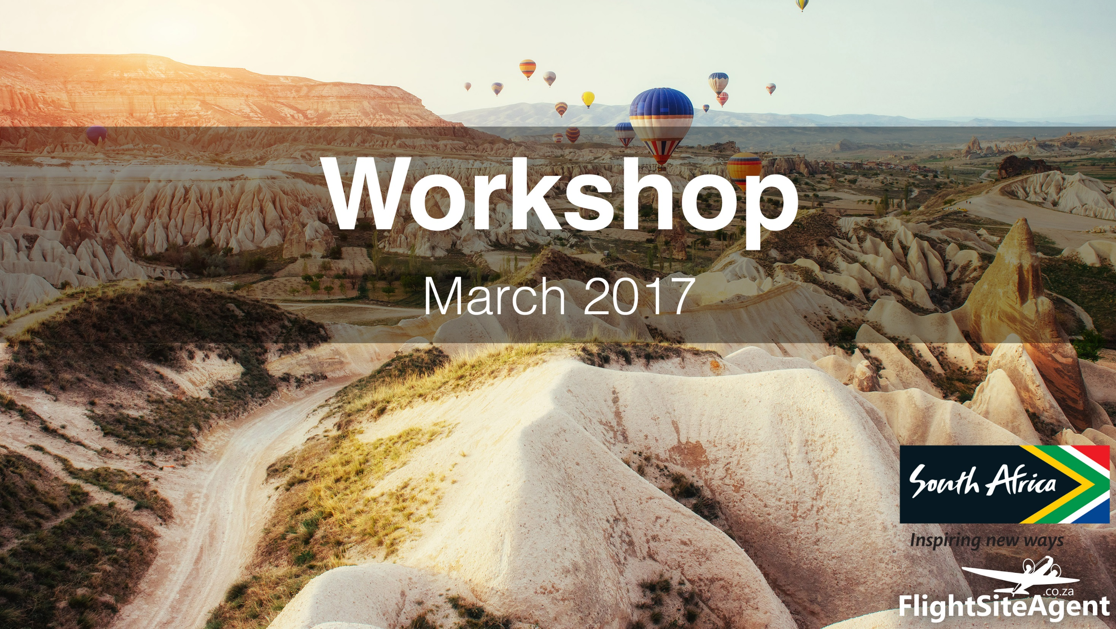
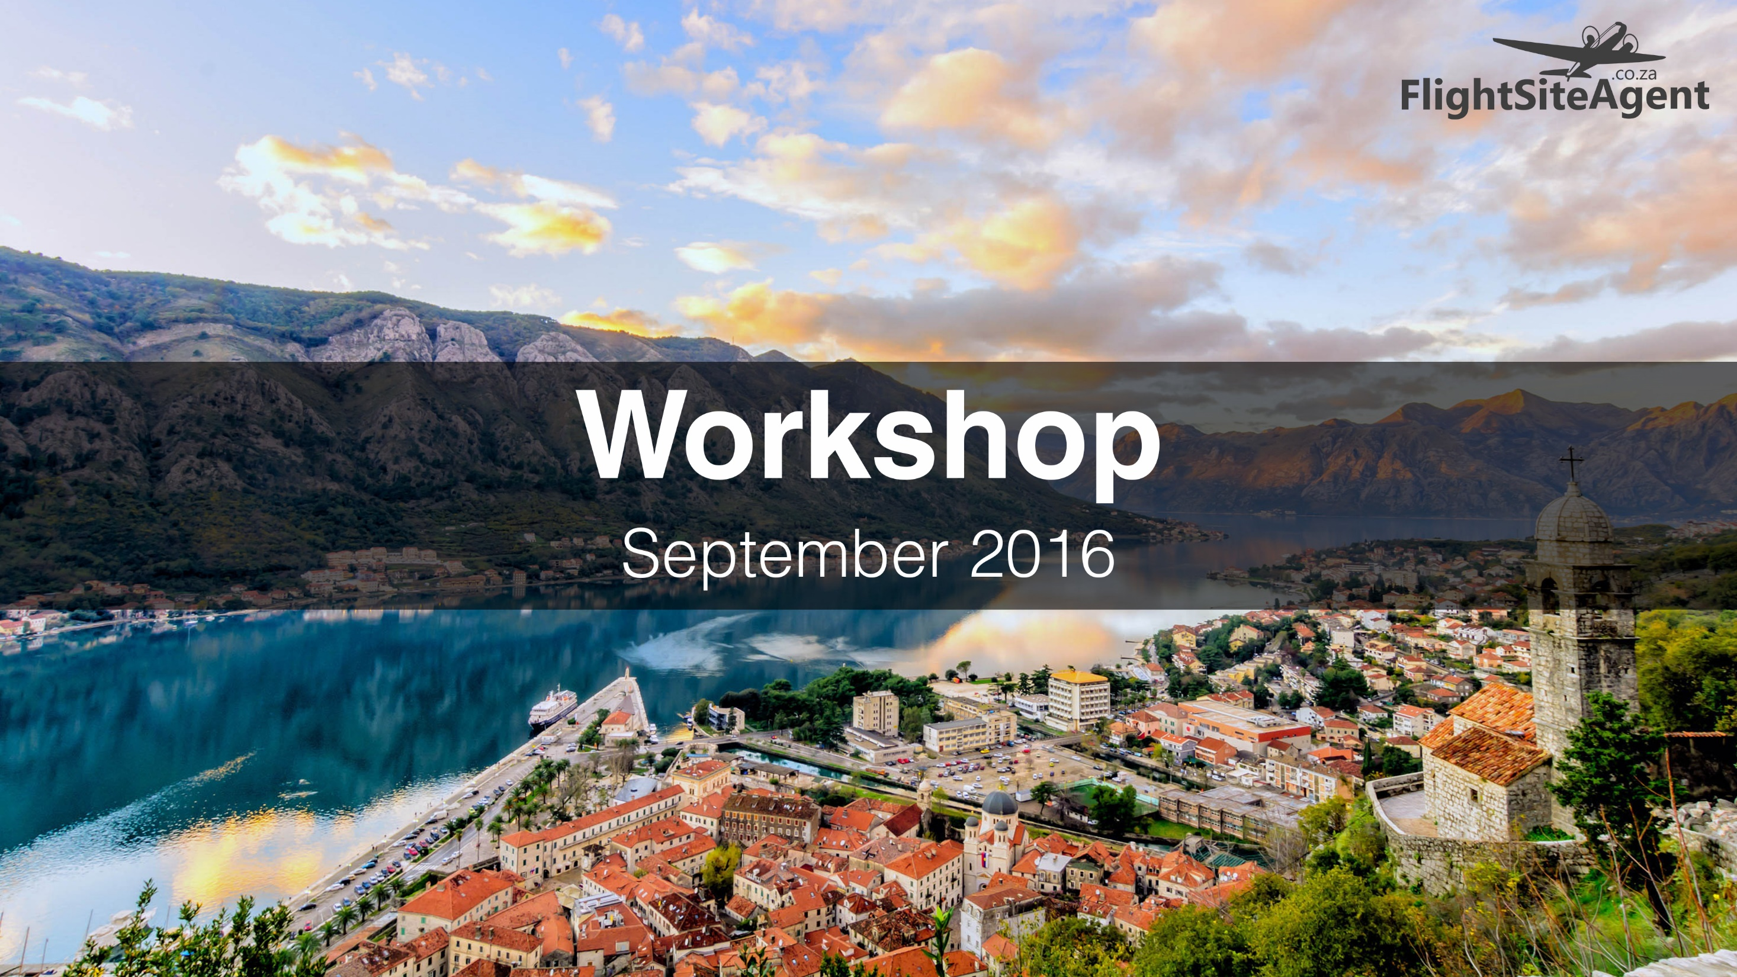

Workshop
September 2016

Slide 2
Agenda
1. Welcome by Rian Bornman
2. SA Tourism Update by Melanie Leloup
3. The Welcome Campaign by Aneshree Rambally
5. Facebook Ads by Astrid Beyers
6. Matooka & Kaashiefa also presented content not on slides

Slide 3
WELCOME
Start a Travel Business today with FlightSiteAgent
Rian Bornman – Managing Director

Slide 4

5 Ideas for Selling Travel in Tough Times
When economic times are tough, many people cut back on luxuries like holidays and travel.
Here are 5 ways to help position travel as an attractive option:
Promote Value
  Focus on value for money, not price e.g. ‘Early bird booking discount’
Sell an Escape
  Encourage prospective customers to take a breather via a short, refreshing get-away.
Create an Experience
  Focus on the experience of travel, such as creating lifelong memories and priceless family moments.
Bundle Options
  Consumers want to feel like they’re getting their money’s worth in a tough economy. Sell package deals, like all-inclusive resorts or cruises.
Business and Pleasure
  Promote the cost saving of a travelling partner

Slide 5
How to Sell a destination you haven’t visited
Here are 11 steps to selling a destination that neither you nor anyone else at your agency has ever visited.
1. Understand it. Begin by asking the client “why,” so you understand what excites them about the destination and what they see themselves doing there. Based on this knowledge you can embark on your research. Word to the wise: Before starting your research, make sure you’re spelling it correctly. You don’t want to research Oakland if your client is thinking about Auckland, or send them to Colombo when they were asking about Colombia.
2. Match it. Even when a client requests a specific destination, you still need to qualify the client so you can see if there is a match between their needs and the destination.
3. Google it. After understanding the client’s reasons for their destination choice, your next step is online research. Narrow your Google search by looking for the top 10 reasons people travel there, top 10 attractions, etc. Read Wikipedia articles to grasp what the country is all about.

Slide 6
How to Sell a destination you haven’t visited
4. Map it. Learn where the destination is located, including surrounding countries, bodies of water, etc. Map work will also give you an idea of the climate as well as possible routings for arriving at the destination.
5. Check it. Look up travel advisories to learn the status of the country, passport and visa requirements, any medical concerns or safety issues, areas of the country that are not appropriate for tourists, the currency situation, etc.
6. Watch it. Experience the ambience and energy of the destination via resources such as YouTube, destination videos, television programs, food TV, guidebooks, travel magazines, newspaper travel sections, online destination reviews, and more.
7. Niche it. Find out if your client has special interests that line up with what is available at the destination – for existing clients, this info should be in your files.
8. Network it. Think of agents and suppliers you’ve met who may know the destination. Contact the tourist board. Check your LinkedIn contacts and query your other social networks. Remember to rely on trusted sources and have healthy scepticism toward anonymous sources.

Slide 7
How to Sell a destination you haven’t visited
9. Present it. Once you’ve done your homework, put together a short story of destination highlights. Include cultural aspects (music, dance, art), as well as attractions, hotel and restaurant choices suited to your client. You can even brand it with your agency logo.
10. Sense it. For a major client or a group booking, you need to go the extra mile. One way to do this is by providing a sensory experience. You can host an info session at your office featuring the destination’s music as well as sample foods from a local restaurant that specializes in the cuisine. Ask the tourist board and suppliers for help providing a feel and taste of the destination.
11. Sell it. Use your selling skills just as you would for any sale. Even if the client seems already convinced that they want this particular destination, you need to match features and benefits and respond to questions and objections. Based on your clients needs, you can discuss the nuances that separate one hotel or resort from the next, dining experiences, activities, etc.

Slide 8
6 Simple Tips to Sell more Travel
There are 6 key elements to a simple system that will optimize your sales conversion:
Quote quickly
  There are 2 tasks here – quickly responding to new requests and responding with an actual quote.
Produce quality quotes
  It isn’t all about speed. The aim of a quote should be to convince the reader that a particular tour operator will provide them with the best holiday.
Follow Up, Follow Up, Follow Up, Follow Up, Follow Up
  80% of sales are made after 5 or more follow ups
Don’t make mistakes
  We are human and planning multi day itineraries can be ridiculously complicated.
Nurture repeat and referral clients
  You should be building a database of relevant details enabling you to build a picture of your database members activity.
Build Trust
  If I believe you’re competent and know that you care about me, I will trust you

Slide 9
Questions?

Slide 10
SA TOURISM UPDATE
Melanie Leloup

Slide 11
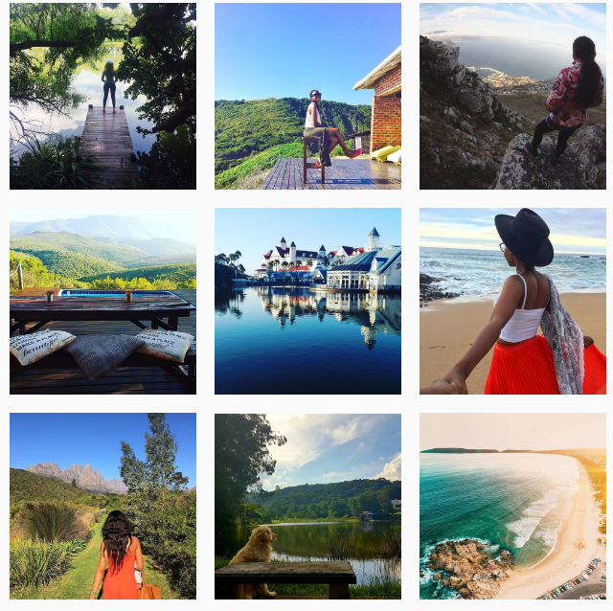
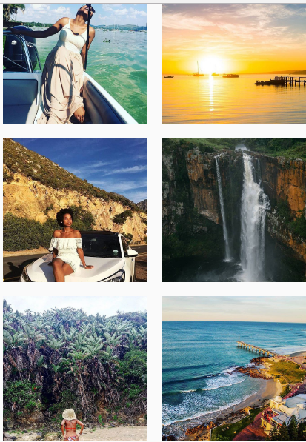
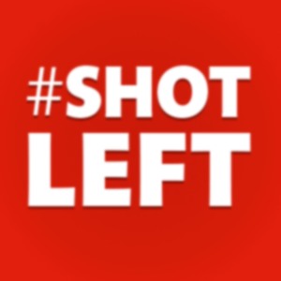

Slide 12
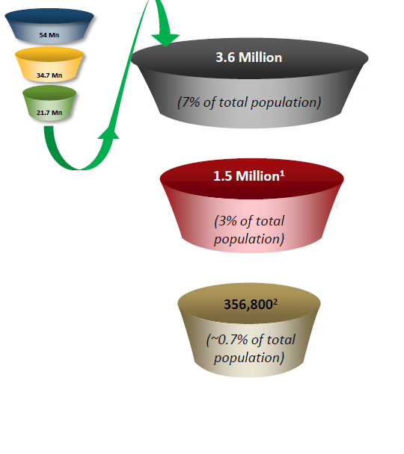
CONSUMER INSIGHTS
21.7m of the total population earn an income.
Only 3.6m earn the threshold of R5000 p.m
BUILD MARKET
CONVERT MARKET
DEFEND MARKET
3.6 million people
1,5 million people
356 800 people

Slide 13
PROFILE OF TARGET SEGMENTS

Slide 14
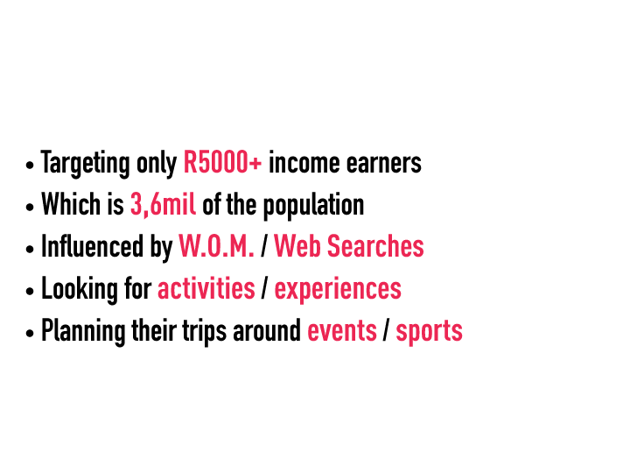
CONSUMER INSIGHTS

Slide 15
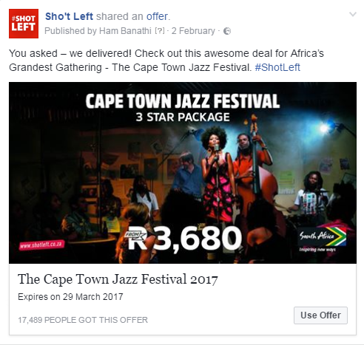
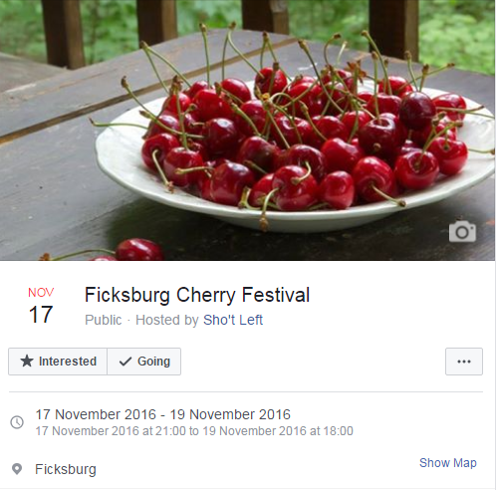
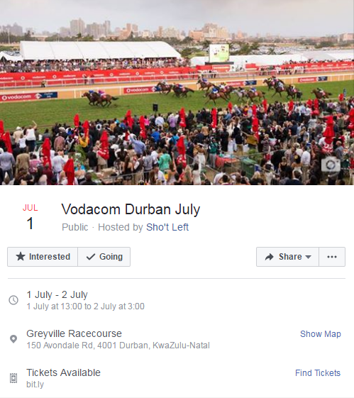

HOW WE USE EVENTS TO SELL TRAVEL

Slide 16
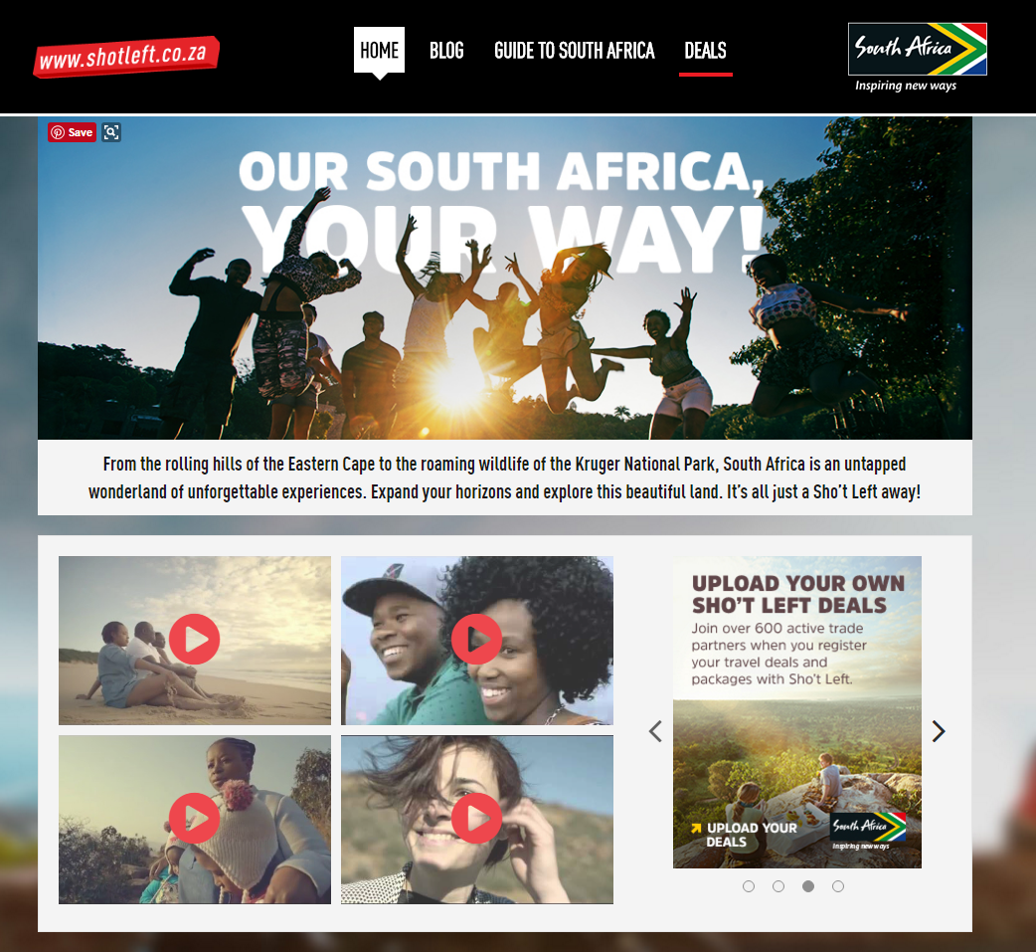

Slide 17
DEALS DASHBOARD
Active Users
3650
Active Deals
476
‘shared’
‘female’

Slide 18
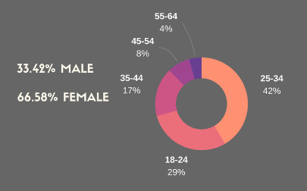
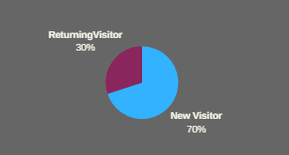
SHOTLEFT.CO.ZA

Slide 19
SHO’T LEFT WEBSITE
Top 10 Experiences Searched
Top 10 Package Searches
Spa
Adventure
Mountain
Bush
Other
City
Coastal
Weekend
Cultural
Day Trips
Package deals in Kwazulu-Natal
Family Package
Package deals in Gauteng
Package deals in Mpumalanga
Package deals in all provinces
Package deals in North West
Package deals in Western Cape
Affordable Packages
Package deals under R500
Self-catering Packages

Slide 20
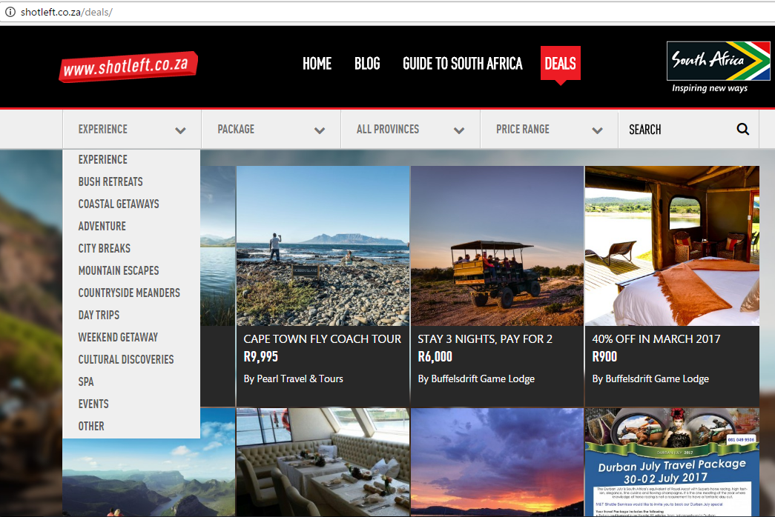
DEALS DASHBOARD
‘shared’
‘female’

Slide 21
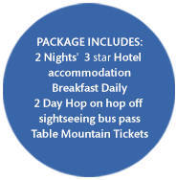
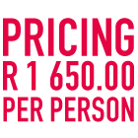
DEALS DASHBOARD
Upload all inclusive deals wherever possible - include attractions and experiences
‘shared’
‘female’

Slide 22
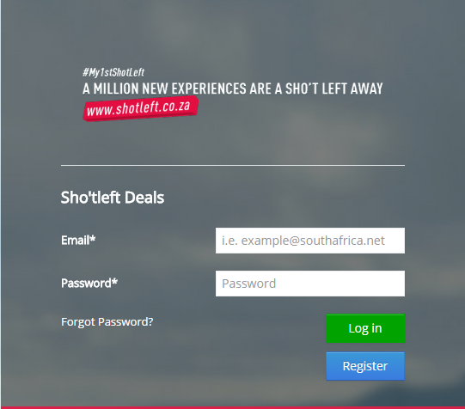
DEALS DASHBOARD
How to Register
Visit the following web address: http://deals.southafrica.net/
and then click on the Register button.
‘shared’
‘female’

Slide 23
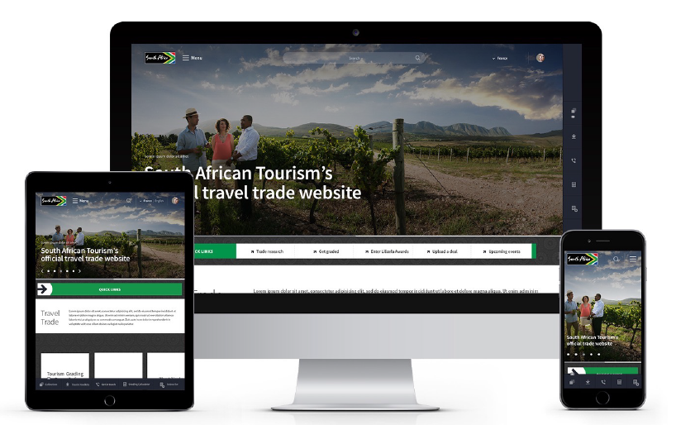
RENOVATION
‘shared’
‘female’

Slide 24
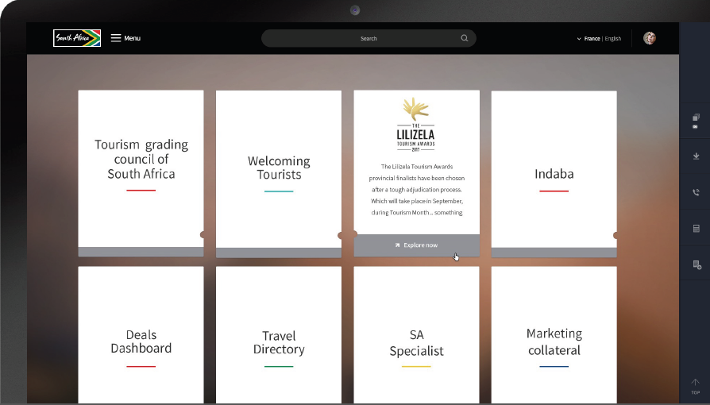
RENOVATION
‘shared’
‘female’

Slide 25
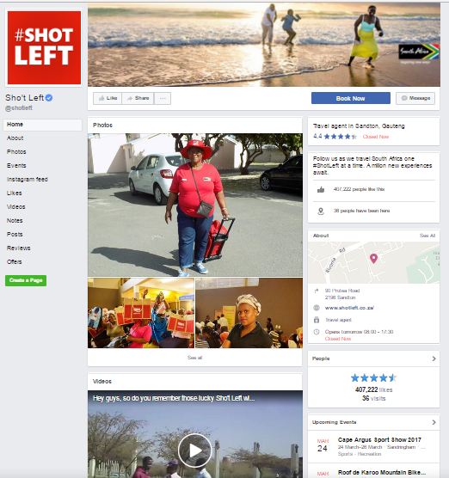
SHO’T LEFT SOCIAL MEDIA
With an active fan base of over
400 000 users and constantly growing month on month, the Sho’t Left Facebook page is key to growing your business and will help you gain exposure to a bigger audience.
This platform is used to inspire, educate and drive incredible travel packages. Our users are extremely active with over 100 queries a day and this platform has driven 138,801 users to our website in the past four months.

Slide 26
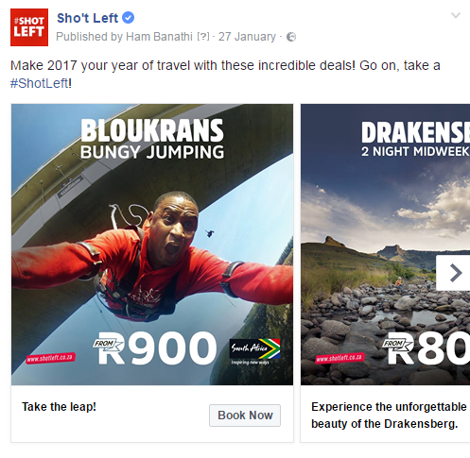
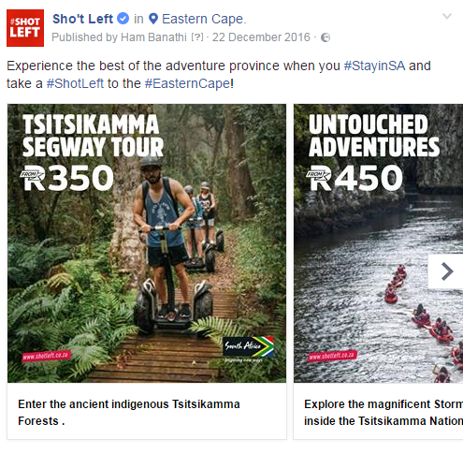

SHO’T LEFT SOCIAL MEDIA
The content produced on this platform reaches an average of 4 million users each month.

Slide 27
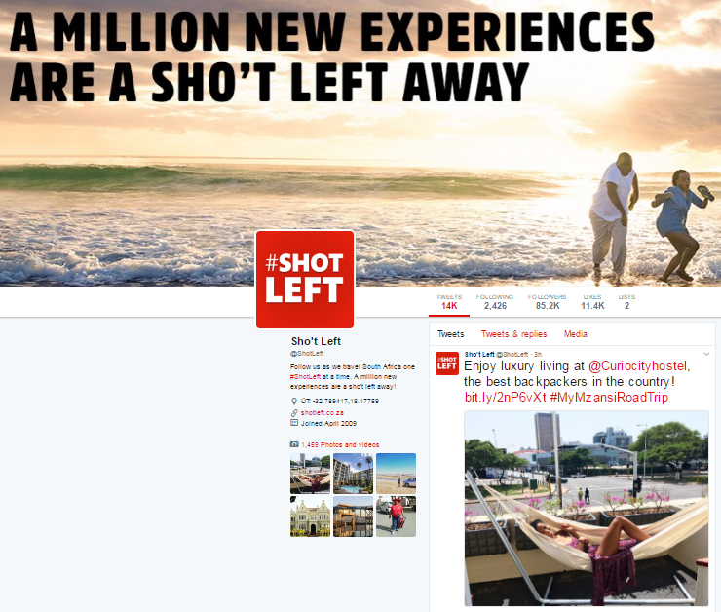
SHO’T LEFT SOCIAL MEDIA
The Sho’t Left Twitter page currently has over 80 000 fans and is growing at a phenomenal rate – a 63% increase in the past four months alone. This account earns over 20 million potential impressions each month and is known for inspiring content and an active community of travellers.

Slide 28
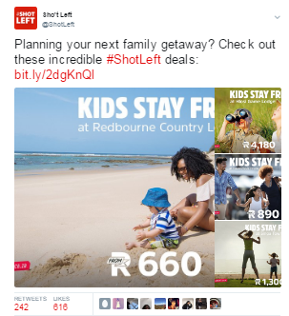
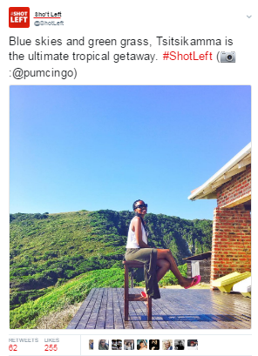
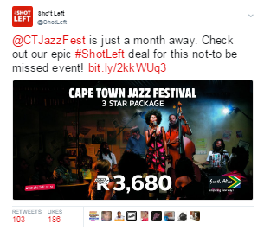



SHO’T LEFT SOCIAL MEDIA

Slide 29
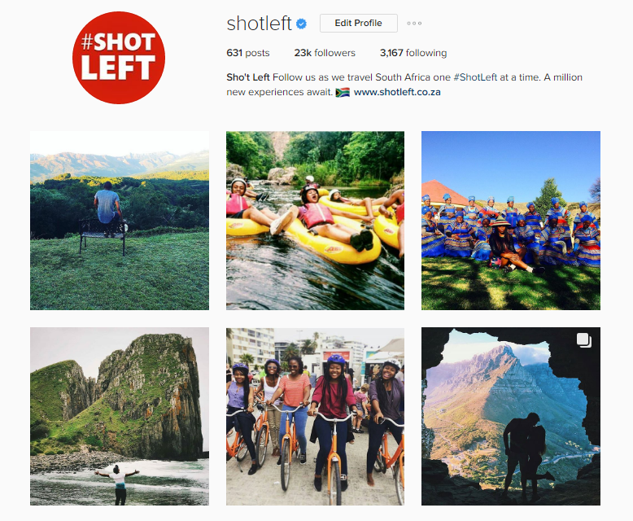
SHO’T LEFT SOCIAL MEDIA
Our Sho’t Left Instagram account has over 20 000 followers with top content achieving over 600 engagements. This platform is used to share user-generated content acts as an inspirational and educational platform.

Slide 30
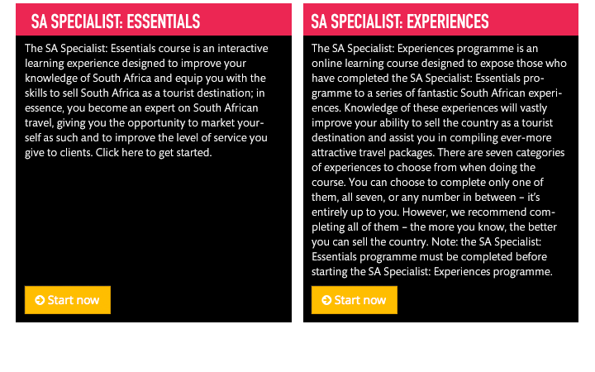
SA SPECIALIST

Slide 31
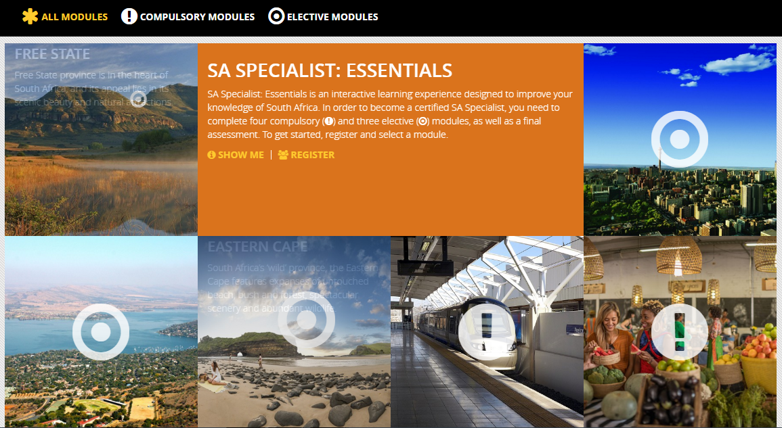
SA SPECIALIST

Slide 32
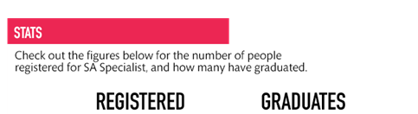

SA SPECIALIST
52 770
13 794

Slide 33
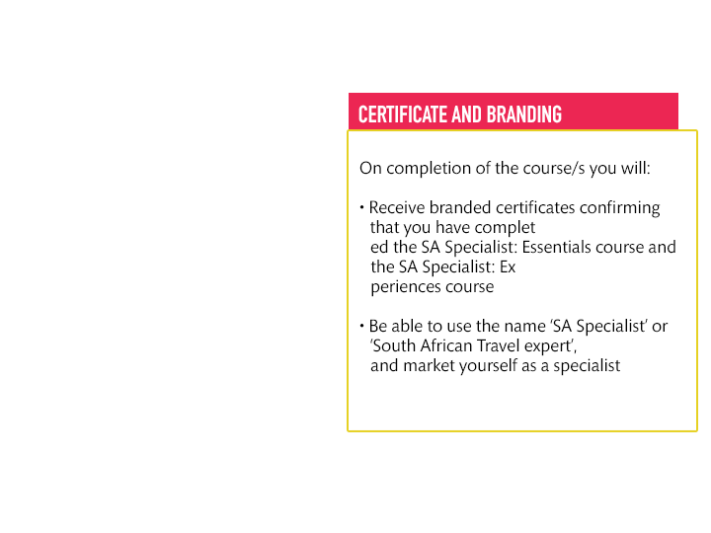
SA SPECIALIST

Slide 34
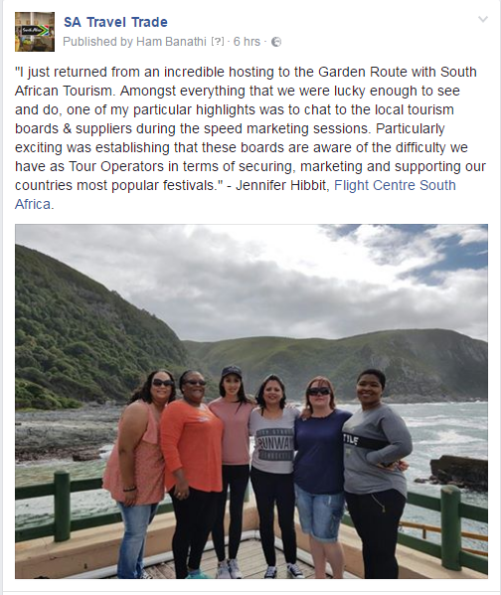
DOMESTIC TRADE HOSTING
South African Tourism has hosted two groups of Domestic Trade, both in the Great Karoo and the Garden Route, where trade partners were invited to discover unique and exciting parts of our South African gems. We used this as a platform to educate and encourage our trade partners to package and upload deals for our consumers.
‘shared’
‘female’
Notes:
This content is amplified across our Trade and Consumer platforms

Slide 35
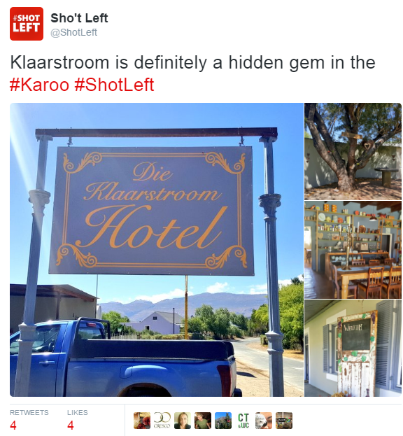
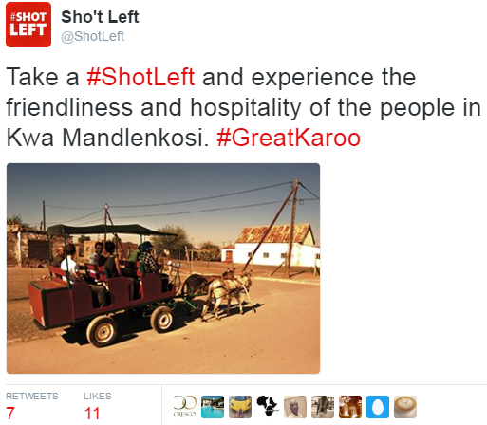
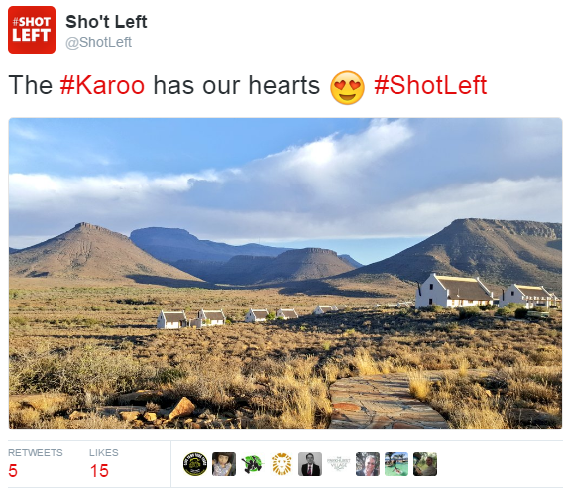
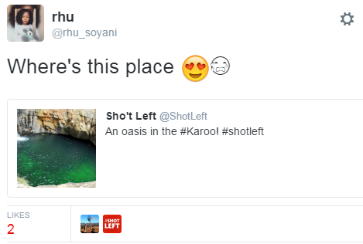
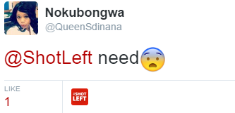
@ShotLeft
‘shared’
‘female’
Notes:
This content is amplified across our Trade and Consumer platforms

Slide 36
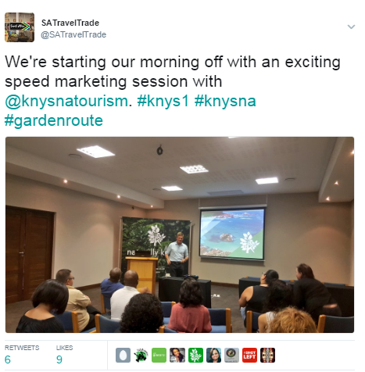
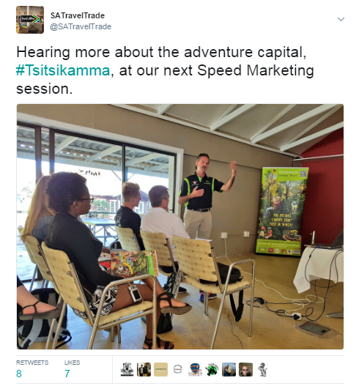
@SA_Travel Trade
‘shared’
‘female’
Notes:
And the feedback has been phenomenal

Slide 38
Questions?

Slide 39
THE WELCOME CAMPAIGN
Aneshree Rambally – SA Tourism

Slide 40





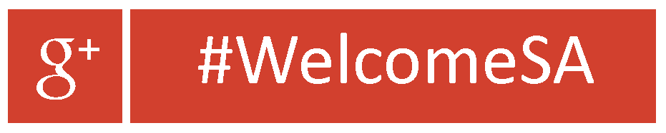

Slide 41


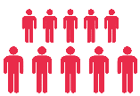






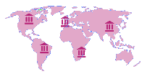




MANDATE AND KEY STRATEGIC OBJECTIVES FOR TOURISM
SA Tourism’s mandate is ...
Sustainable
GDP growth
Sustainable
job creation
Redistribution and transformation
Increase in
tourist volume
Increase in
tourist spend
Increase in
length of stay
... through six key
objectives …
Improved
geographic spread
Improve
seasonality patterns
Promote transformation
Understand
the market
Choose the
attractive segments
Market the
destination
... by acting in a
focused way to...
Facilitate the
removal of obstacles
Facilitate the
product platform
Monitor and learn from tourist experiences

Slide 42
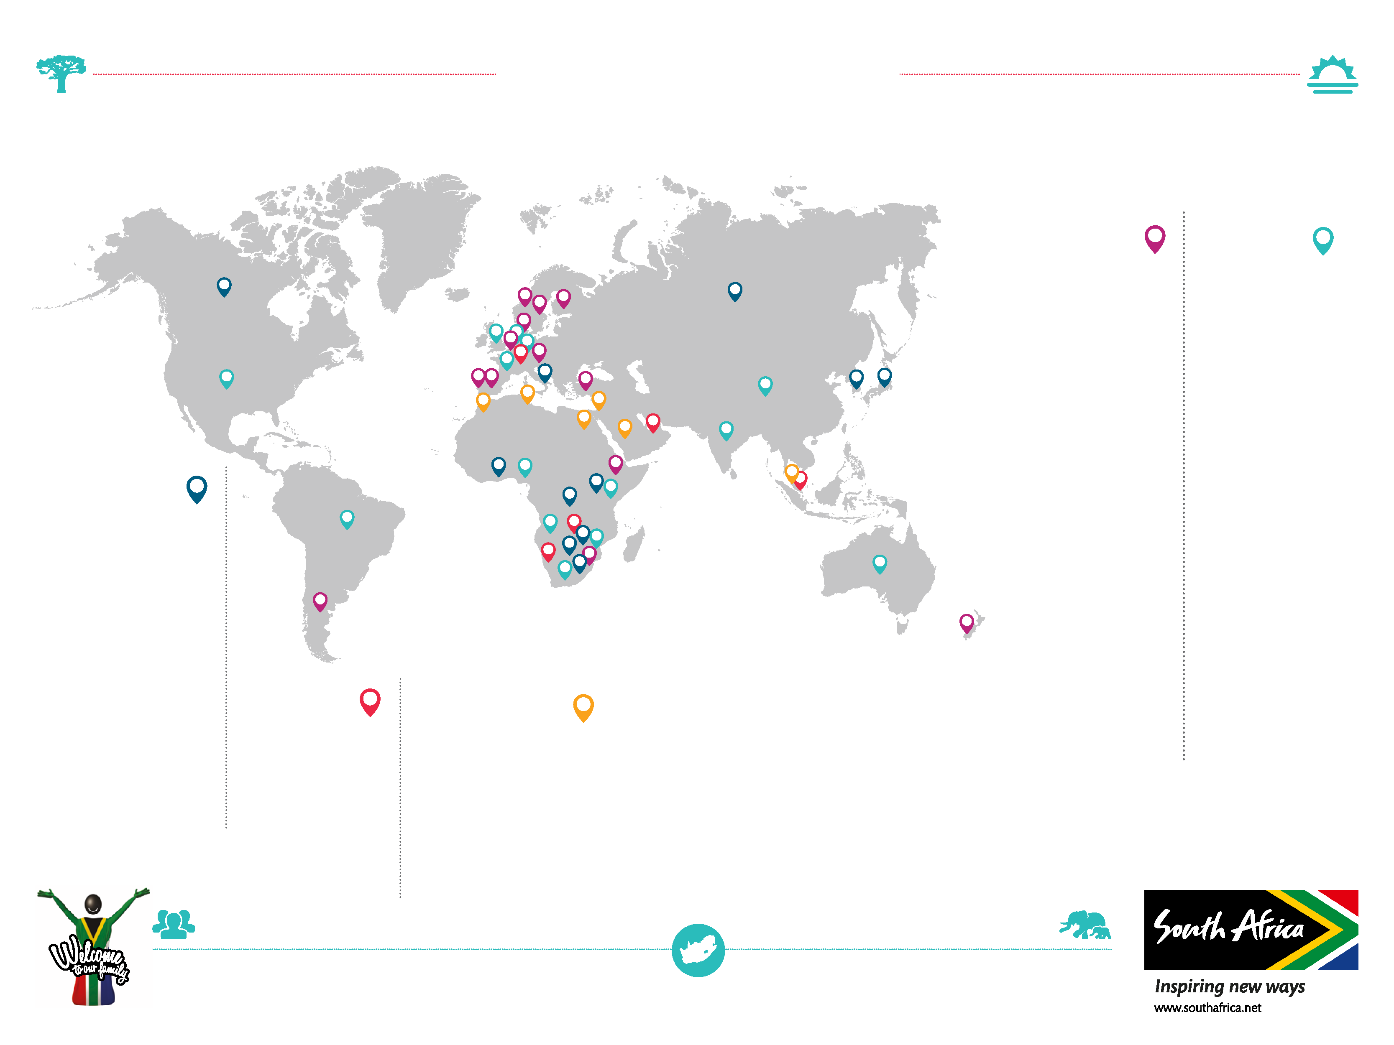


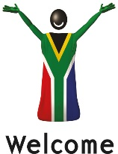
MARKETS DEFINED
2014-2017
WATCH-LIST MARKETS
• Malawi
• Swaziland
• Ethiopia
• Argentina
• New Zealand
• Austria
• Denmark
• Belgium
• Norway
• Sweden
• Finland
• Turkey
• Spain
INVESTMENT MARKETS
• DRC
• Lesotho
• Canada
• Zimbabwe
• Japan
• Botswana
• Ghana
• Uganda
• South Korea
• Italy
• Russia
CORE MARKETS
• Angola
• Mozambique
• Kenya
• Nigeria
• Domestic (South Africa)
• USA
• Australia
• France
• Germany
• Netherlands
• UK
• Tanzania
• Brazil
• China
(incl. Hong Kong)
• India
TACTICAL MARKETS
• Namibia
• Zambia
• UAE
• Switzerland
• Singapore
STRATEGIC IMPORTANCE
• Egypt
• Israel
• Saudi Arabia
• Morocco
• Tunisia
• Malaysia

Slide 43
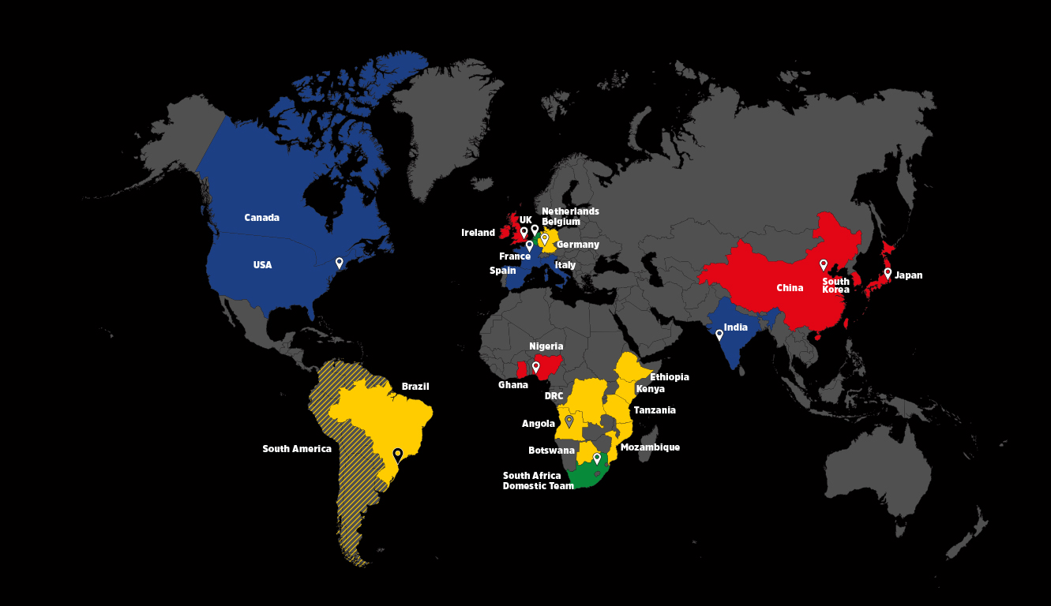

Slide 44
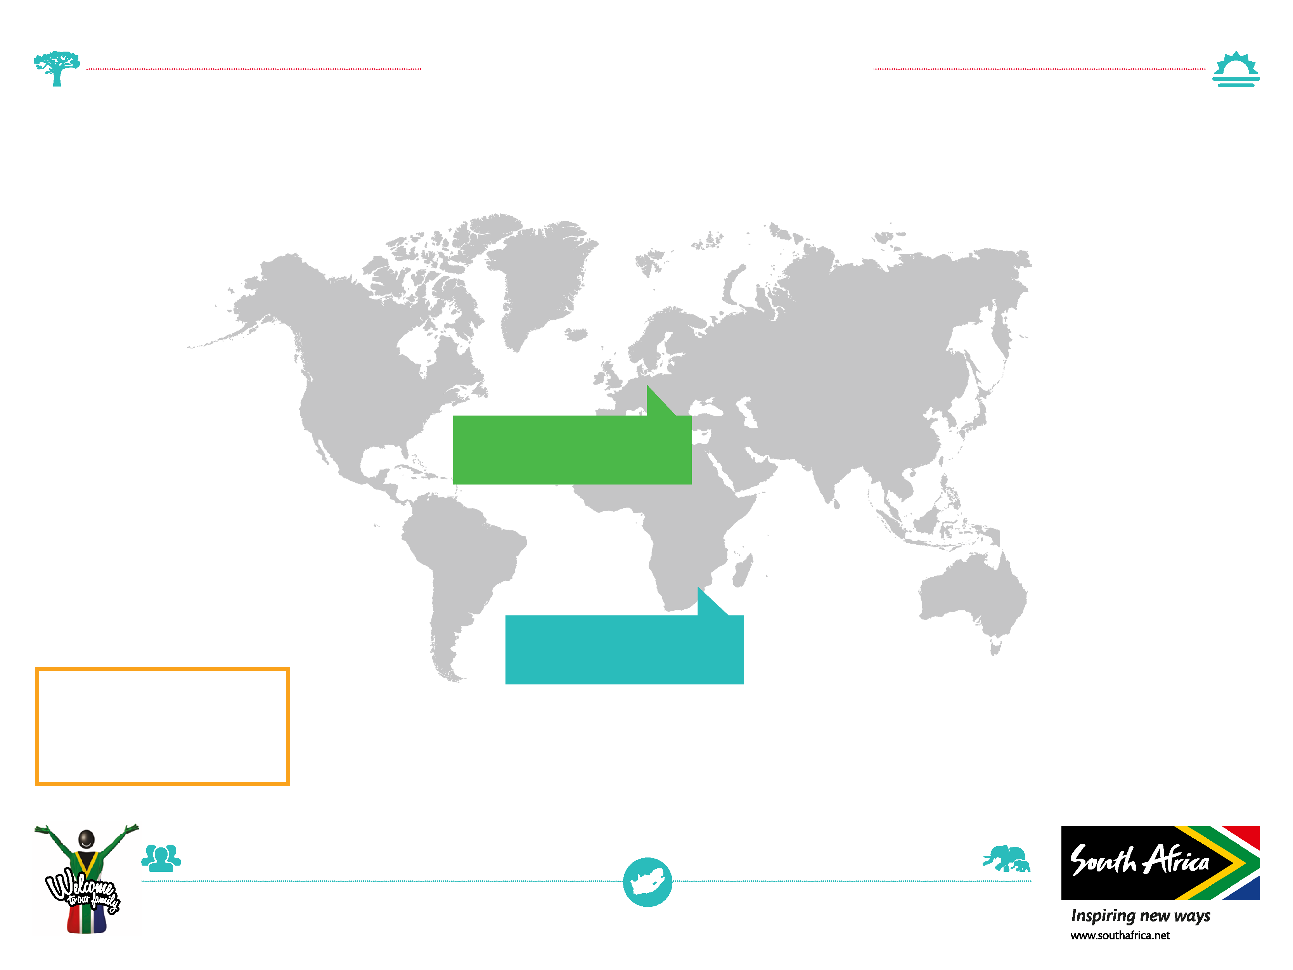

TOURIST ARRIVALS
2016
1. Africa
7,472,494
16%
5. Australasia
131 910
10%
2. Europe
1 525 836
15.8%
6. Central and
South America
67 546
30.3%
3. Asia
328 030
30 %
Largest long-haul
traffic for South Africa
3. Middle East
71 532
34%
4. North America
406 192
15%
Largest traffic overall
for South Africa
GRAND TOTAL
10, 003,540 improved
18% from 2015
8. Indian Ocean Islands
29 018
24%

Slide 45
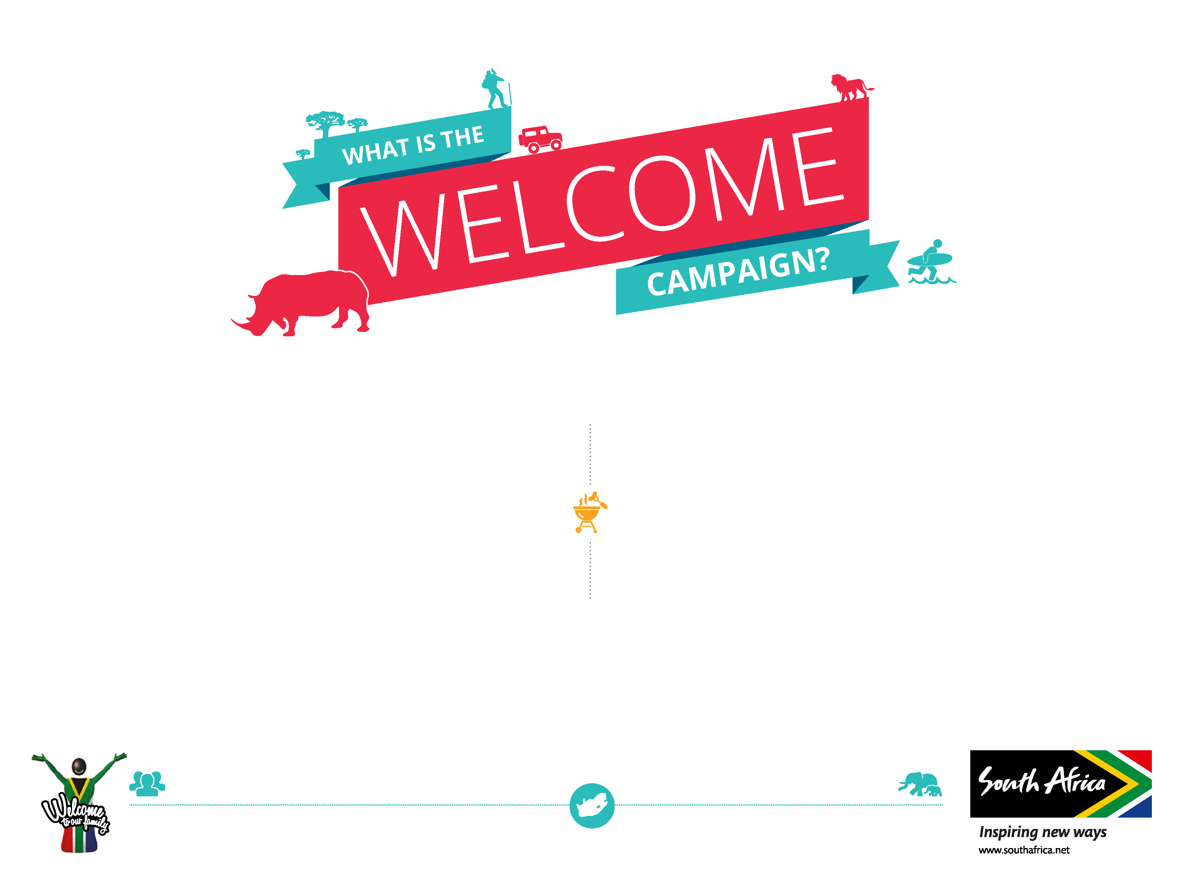
Welcome is a South African Tourism initiative which aims to inspire, educate and empower the South African tourism role players and everyday South Africans to exceed tourist expectation for service delivery and welcoming interactions, thus deliver and showcase our brand promise.

Slide 46
WHO IS THE
INTIATIVE FOR ?
The Welcome initiative is for all members of the tourism industry, from seasoned tourism business owners to start-ups

Slide 47

WELCOME TOURISM VALUE CHAIN
Tourist touch points

Slide 48
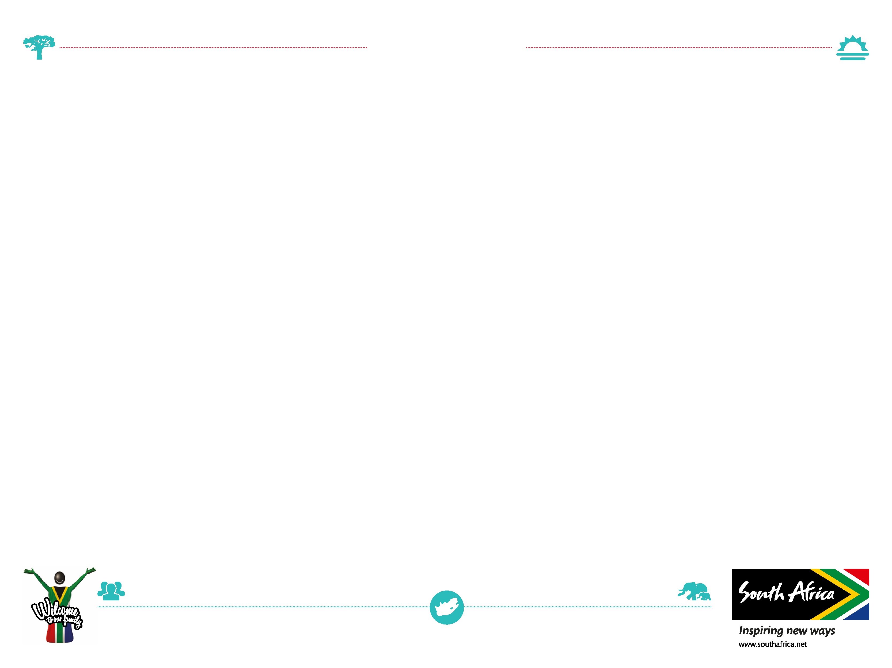
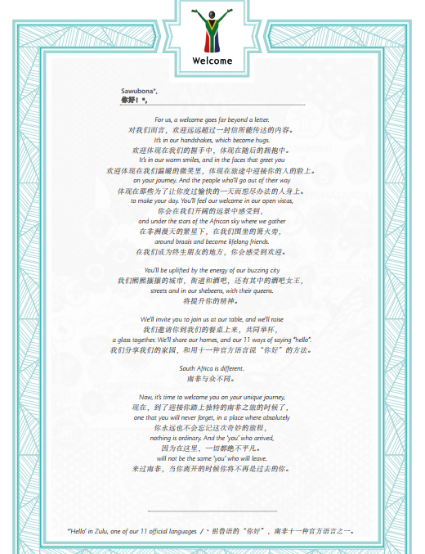
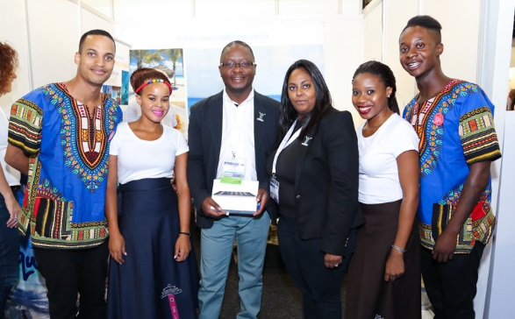

WHAT DO YOU
AND HOW DO WE DO IT?
Letters & Fact sheets
We develop toolkits and package information to better equip industry to serve tourists better
We do it on two main platforms, online and workshops
Workshops

Slide 49
PROJECTS
Ports of Entry project
WOW Makers campaign
SATSA SMME development
Provincial Welcome Workshops
NDT Capacity building

Slide 50
Questions?

Slide 51
FACEBOOK ADS
Astrid Beyers – Content Manager

Slide 52




COMMUNICATION CHANNELS
1. Social (Facebook & Twitter)
#TravelAlert For Travelinfo.co.za news
e.g. visa regulation changes, flight cancellations, etc.
#AgentAlert Specials that could benefit your clients
2. Newsletters
We share the latest specials including all relevant
details and downloadable images for your promotions.
Also share the most important news stories of the week.
3. Blog
Create content around your needs.
Please send through suggestions!
Sign up on the
website here →
MARKETING TIPS

Slide 53


EXAMPLES OF FACEBOOK ADS
Brand Awareness ad
+ button
Engagement for Page Likes
Like page button
Clearly marked
Product catalogue sales – using Cookies
P.S. Did you know your Facebook ads can also display on Instagram? No IG account required!
Newsfeed
Desktop Right Feed
MARKETING TIPS

Slide 54
HOW TO USE FACEBOOK ADVERTISING
1. Need to have a Facebook Business Page
You need to be the manager of a Facebook business page in order to run paid promotions. Most of you will already have a FB Business account.
If you don’t have one, all the convincing you need is that it is free and quick and easy to set up. It can be a powerful marketing tool for your business.
You can download our previous workshop’s slides here to find out how to set up the page step-by-step.
MARKETING TIPS

Slide 55
2. Purpose of Facebook
The real value in a Facebook page, or any social media account for a business, doesn’t lie in its ability to potentially attract new customers but rather the ease and affordability with which you can push your content onto others.
You can amplify this ability to push your products by putting money behind it.
What makes Facebook marketing even more unique than any other traditional marketing method, say an advert in a newspaper, is that you can specifically target people who have either already shown an interest in your business or who has an interest in businesses like yours.
MARKETING TIPS

Slide 56
3. Consider the outcome you want
Facebook ads give you endless possibilities, but you need to consider what the desired outcome is before you even open up the Ads Manager.
Don’t have unrealistic expectations. Research has shown that Facebook ads are great for creating brand awareness and to amplify your marketing efforts, but followers who have been “bought” rarely convert into clients.
Facebook is a great tool to connect with your most loyal followers (those who sought you out on social media). You can boost your communications on Facebook to ensure that all your followers get the message.
MARKETING TIPS

Slide 57
So although it is completely possible to gain ten thousand new followers by promoting your Facebook page (even with people that have an interest in your business field), there is no value in appearing popular if your followers aren’t buying your product.
Initially campaigns like this might have had a larger success rate, but as we are in the age of social marketing where everyone is trying to sell you something all the time- these campaigns have lost their impact.
The followers you gained organically are the ones that are really valuable – as they are the ones that are already predisposed to make use of your services and purchase your products. Sometimes they just need a little nudge or reminder.
MARKETING TIPS

Slide 58

4. Facebook Ad Options
There are three ways of spending money on Facebook that you need to know about:
1. Ads Manager - Found in the dropdown on the right hand-side of the main menu on Facebook under the heading “Create Ads”.
2. Boosting Posts - Button found on post.
3. Promoting Pages - Button found on page management.
MARKETING TIPS

Slide 59

BOOST A POST
Click on “Boost Post” at the bottom of the post you’ve created on your page. Special offers, airline specials, amazing package deals and important updates are all posts worth boosting.
Select the audience you are interested in targeting.
You can speak to the people who like your page or to them and their friends, to a custom audience (created in the Ads Manager) or to People you choose through targeting.
If you’re looking for the best return on value, choose the people who like your page. This is a great way to ensure that they see your posts in their news feed as Facebook rarely shows page posts to more than 1% of followers to that page organically. You can narrow this further down by region, which is valuable if you want to for example boost a special on flights from Durban.
MARKETING TIPS

Slide 60

Set your daily budget. Minimum spend is R10 per day. Facebook will calculate the total cost based on the ad duration and then bill it to the credit card associated with your account.
You can set the duration of the ad by either selecting the options 1, 7 or 14 days or you can choose the ad’s end date.
Finally you have to choose your payment method and then you’re all set to click on Boost!
Your ad will then be submitted for approval. Aside from the general posting rules, you can’t boost a post containing an image with more than 20% text (excluding infographics, magazine covers, etc).
Get more info on Facebook’s advertising policies here.
MARKETING TIPS

Slide 61

Facebook Ads Manager
Brand Awareness & Engagement
MARKETING TIPS

Slide 62
As you can see, it is quite overwhelming. Most of this is geared towards people who sell physical products, sell services or products on their website or have physical shop fronts, which is why I have crossed out those options.
There are likely only two options you’ll ever use:
1. Brand Awareness: Reach people who don’t follow your page, but who would be interested in it, and show them your ads to increase awareness of your brand.
You can show them ads in their newsfeed through either video content, an image, an image carousel or a slideshow (looping video) or canvas (images & video combined).
It is possible to target people with specific interests, locations, age groups, etc. or target people with similar profiles to your current audience (Lookalike Audience).
MARKETING TIPS

Slide 63

2. Engagement: Get more people to see and engage with your post or Page. Engagement can include comments, shares, likes, event responses and offer claims.
I’d recommend Post Engagement, which basically means you are boosting a post so that more people can see it. As mentioned, page likes have little marketing value and Event responses and Offer claims likely aren’t relevant to you.
The results will be fairly similar to the Boost Post option, but this option also allows you to create a Custom Audience or a Lookalike Audience.
Minimum budget spend is R10 a day.
MARKETING TIPS

Slide 64
So swinging back to your desired outcome :
Did you have something you want to tell your audience?
Like a special, a new service you offer, etc.
=Post boost/ Post Engagement (Ads Manager)
Do you want to increase your brand awareness?
  Let more people know that you’re a travel agency. Share amazing specials and deals that sets you apart from the rest.
  =Brand Awareness Ad
Do you want more followers?
  Either create a page ad targeting a custom audience of all your newsletter subscribers (existing clients) email addresses or skip the ads all together and invite your friends and family to your Facebook page.
  There is no real marketing value in having more followers, especially if they aren’t clients first.
MARKETING TIPS

Slide 65


5. Targeting your ads / Selecting Your Audience
Brand Awareness/ Engagement

Slide 66
Custom Audience
You can either create:
A Custom Audience that has already interacted with your business (newsletter sign-ups, using a Pixel (Cookies) for website visitors, etc.
A Lookalike Audience is new people on Facebook who are similar to your most valuable audience.
Locations
You can choose someone who either lives in this location, has recently been at this location or someone who travelled in this location.
It could be a country, province, city or suburb.
You’ll want to target your audience geographically if you are promoting a self-drive vacation in specific region, a flight sale that is only ex. Cape Town, etc.
Detailed Targeting
You can add demographics, interests or behavioural attributes you think a client of yours will likely have.
Allows you to target people who follow your competitors – Lekkeslaap.co.za, flight centre south africa, Travelstart, etc.
The more you add, the more possible matches there will be. Someone only has to match one of the parameters to be eligible.
MARKETING TIPS

Slide 67
Age, Gender and Language
If you know your target audience well, then it is worth playing around with this.
If you are unsure, rather be inclusive than exclusive and potentially miss out on someone you deem to young to travel.
Connections
This allows you to target people who have interacted with your Facebook page, Events or Apps.
You can either specifically include or exclude those who like your Facebook page or you can include people who like your page and their friends.
You can save your audience for future use.
MARKETING TIPS

Slide 68

6. Ad Placements
Facebook usually displays your ads on both Facebook and Instagram. You can choose either one or the other and even choose where on Facebook your ads shouldn’t show.
Typically ads perform better in the newsfeed than in the right column, which is reserved for ads and receives less attention.
MARKETING TIPS

Slide 69

7. Budget & Schedule
Essentially, your daily budget allows Facebook to bid on your behalf to display ads to your chosen audience. You compete with in an auction with other advertisers who have chosen the same target audience. Hence you’ll find Facebook doesn’t always spend your entire budget.
It is usually recommended to leave your ad delivery optimised for post engagement. You don’t want to spam users multiple times per day.
You can play around with the rest, but it’s usually best left to Facebook to know when to show your ads to your audience.
MARKETING TIPS

Slide 70

8. Ad Creatives
Let your ad visuals and text be guided by the end goal.
i.e. if the goal is brand awareness, make sure the image embodies some element of your brand.
You want to create a clear, strong image as it needs to be something that grabs your audience’s attention whilst they are scrolling through their feed.
Limit your text to only the essential, but steer clear of “Whatsapp language” and unnecessary abbreviations.
Make sure to check Facebook’s image size guidelines for your particular image placement.
MARKETING TIPS

Slide 71


Brand Awareness & Call to Action Button
In the “Advanced options” you can add a website URL and then a corresponding “Call to action” button.
Call to action button
MARKETING TIPS

Slide 72

9. Ads Manager
Want to know how your ad is performing? Facebook will send you a summary via email as soon as your ad has stopped running, but you could also check this on the Ads Manager.
This gives you a dashboard view of stats on all the ad campaigns you’ve ever run, including boosted post and page like ads.
MARKETING TIPS

Slide 73
10. Final Assessment
Each audience is unique, there really is no general formula that will give you results each and every time. The only way to find out what really works is by trying things and checking the results on the ads manager.
If you see an ad is performing incredibly well, you can add to the budget and extend its run.
If you see an ad is underperforming, you can “pause” it – which effectively means you’re cancelling it.
If you are really happy with how something turned out, you can click on it in the ads manager and create a similar campaign or duplicate it.
MARKETING TIPS

Slide 74
IF YOU ARE STILL UNCERTAIN ABOUT ANYTHING
Facebook Business itself has some great articles to guide you through the processes
Google is your friend – you’ll find tutorials and some great tips and tricks
I’m also happy to help if you are stuck – info@flightsiteagent.co.za
The more you practice, the more certain you’ll be!
MARKETING TIPS

Slide 75
Questions?

Slide 76
Prize Draw

