Slide 1
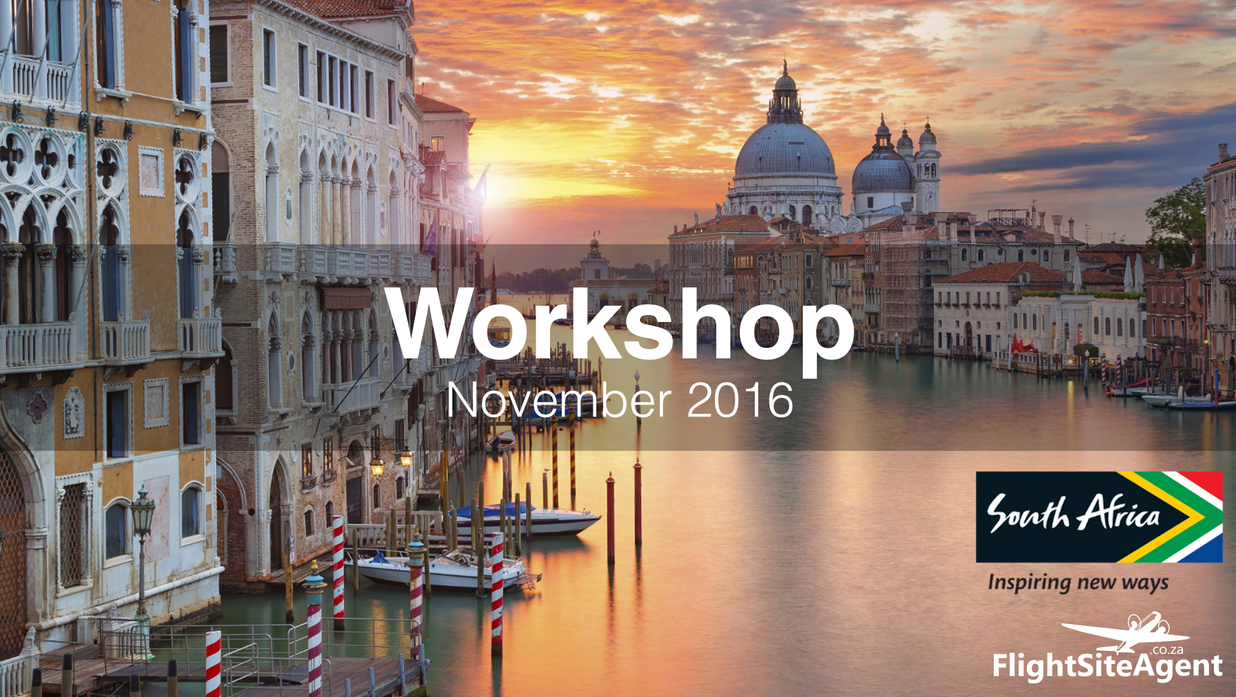
Workshop
September 2016

Slide 2
FlightSiteAgent Workshop Agenda
1. Welcome by Rian Bornman
2. System Training by Matooka Boltman and Kaashiefa Kolia
3. Marketing by Astrid Beyers
How to build a client base & marketing yourself
Setting up a Facebook business account
4. Domestic Tourism Update by Melanie Leloup
5. SA Tourism Welcome Campaign by Aneshree Rambally

Slide 3
MARKETING TIPS
HOW TO BUILD A CLIENT BASE &
STEP-BY-STEP CREATING A FACEBOOK BUSINESS PAGE
Astrid Beyers – Content Manager

Slide 4
YOUR MARKETING TOOLS
Yourself
(2) Friends and Family
(3) Social Media
MARKETING TIPS

Slide 5
Our number one question from FlightSiteAgents:
“Where will I get clients?”
MARKETING TIPS

Slide 6
But a successful travel company doesn’t just service a few people that need flights, it’s about building a solid client base that is continuously growing.
This means having both returning clients and new clients.
MARKETING TIPS

Slide 7
MARKETING YOURSELF
Before you want to approach friends and family!
You not only represent your business, you ARE your business.
Even in your personal capacity, everything you do reflects on your business.
Perfect your “elevator pitch” - A brief, persuasive speech that you use to spark interest in what your company does. Focus on what sets you apart from your competitors.
Become a travel expert:
Become comfortable with the FSA system
Stay up to date with industry news and developments (FSA Facebook & Twitter accounts)
Network – The more people you know, the more you can market yourself to!
MARKETING TIPS

Slide 8
MARKETING TO FRIENDS & FAMILY
Don’t treat them as a test-run, but rather a demonstration of your abilities.
Remember that you aren’t asking them for a favour, but an opportunity to prove yourself.
Even though they are your friends/family, treat them like a client and act professionally.
Qualify them like a client, it might be awkward but ask for a budget and stick to it and provide professional quotes.
Say no to “friends and family discounts”. Rather offer extras like personal airport transfers or online check-ins, but don’t undercut yourself and offer a discount you can’t sustain.
Making the booking should be the end, let them become your ambassadors! Encourage them to share on social media and provide honest testimonials that you can use for marketing.
MARKETING TIPS

Slide 9
MARKETING TO FRIENDS & FAMILY
What if your friends and family can’t afford to travel or don’t want to travel in the immediate future?
You can still ask them to put your services to the test by allowing you to quote them on something (practice makes perfect).
This will make both you and them more confident in your abilities and more likely to encourage their friends to make use of your services.
MARKETING TIPS

Slide 10
How do you go beyond your friends and family?
Think about what you’d do if you’re looking for someone to deliver a service. If friends and family can’t recommend someone suitable, you’ll likely turn to the internet.
Having an online presence has become non-negotiable for all businesses!
Social media is great for smaller businesses as you can tailor-make it to fit your budget.
MARKETING TIPS

Slide 11
SOCIAL MEDIA
If you’re unfamiliar with a company, you’ll be extra sceptical.
Determine a company’s credibility through:
Testimonials – these are especially valuable when on Facebook as you can see who made the testimony.
A physical address
Contact numbers
Email addresses ( Especially customised ones e.g. not @gmail.com)
Being active online ( a dead account doesn’t inspire confidence)
MARKETING TIPS

Slide 12
Online presence = Facebook Business Page
Why?
It’s free
Easy to set up
Easy to maintain
Allows for interaction from your followers
Allows customers to rate your service (provide testimonials which
seem more trustworthy)
Social aspect allows customers to share and tag your business,
increasing visibility and brand recognition

Slide 13
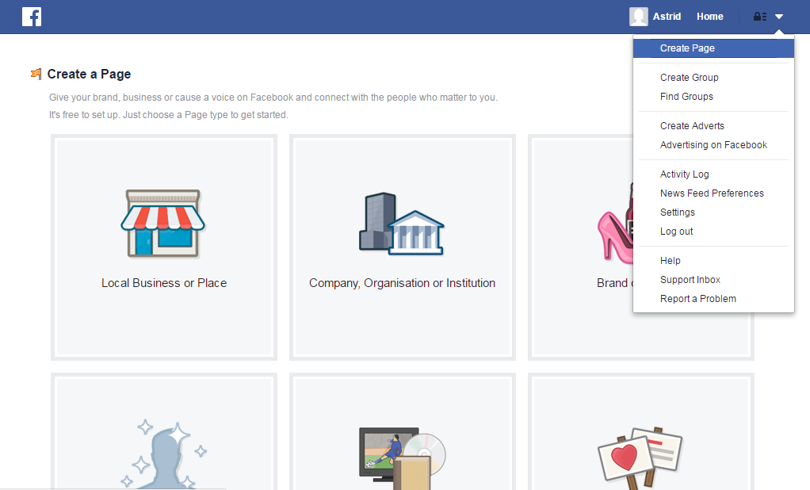
HOW TO SET UP A FACEBOOK BUSINESS PAGE
MARKETING TIPS

Slide 14
HOW TO SET UP A FACEBOOK BUSINESS PAGE
MARKETING TIPS

Slide 15
HOW TO SET UP A FACEBOOK BUSINESS PAGE
MARKETING TIPS

Slide 16
HOW TO SET UP A FACEBOOK BUSINESS PAGE
You can change your profile
picture later on.
What should be your profile picture?
Your logo is the most natural choice,
not your face. You want something
that will be easy to identify even
when it is really small scale.
MARKETING TIPS

Slide 17
HOW TO SET UP A FACEBOOK BUSINESS PAGE
This is just for quick reference.
MARKETING TIPS

Slide 18
HOW TO SET UP A FACEBOOK BUSINESS PAGE
Choose the country you’d like to target.
You could go as far as choosing a suburb,
but the more you specialise the more
potential customers you could be missing
out on.
When you are promoting your page with
money, it is a good idea to target your
niche market and this could mean
narrowing down the area.
MARKETING TIPS

Slide 19
HOW TO SET UP A FACEBOOK BUSINESS PAGE
MARKETING TIPS

Slide 20
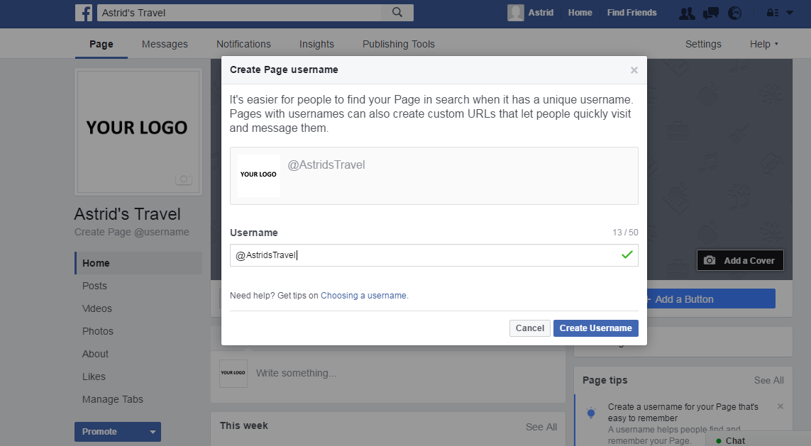
HOW TO SET UP A FACEBOOK BUSINESS PAGE
1: Set Up a Custom Use
Name
Allows people to tag your
page using what could be
something shorter than
your page/business name.
Also gives you a custom URL
MARKETING TIPS

Slide 21
HOW TO SET UP A FACEBOOK BUSINESS PAGE
2: Upload you cover photo
Something relating to travel.
Should be landscape
Take care to position it so that I
it doesn’t cut anything off.
Min size of 851 x 315 pixels.
Anything larger than that is
good.
MARKETING TIPS

Slide 22
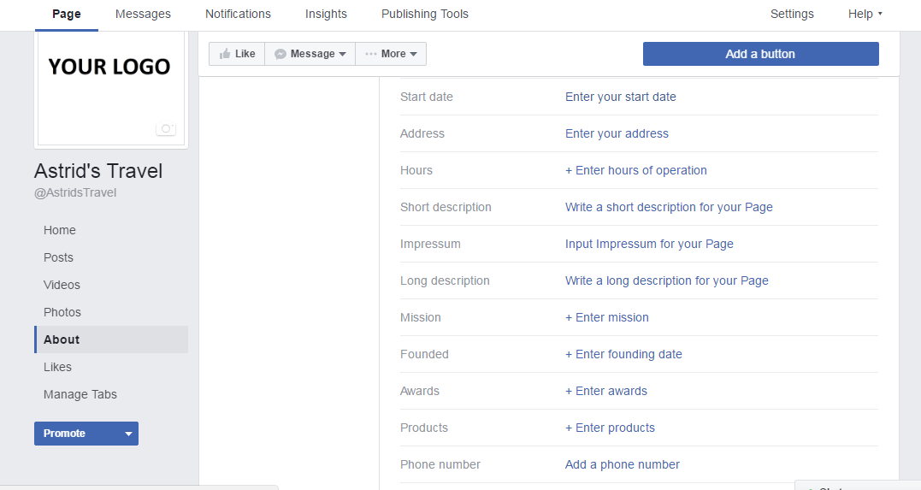
HOW TO SET UP A FACEBOOK BUSINESS PAGE
MARKETING TIPS

Slide 23
HOW TO SET UP A FACEBOOK BUSINESS PAGE
How do you get page likes?
Posting content that is engaging (beautiful pictures, relevant
information & competitions)
Inviting your friends to like your page
MARKETING TIPS

Slide 24
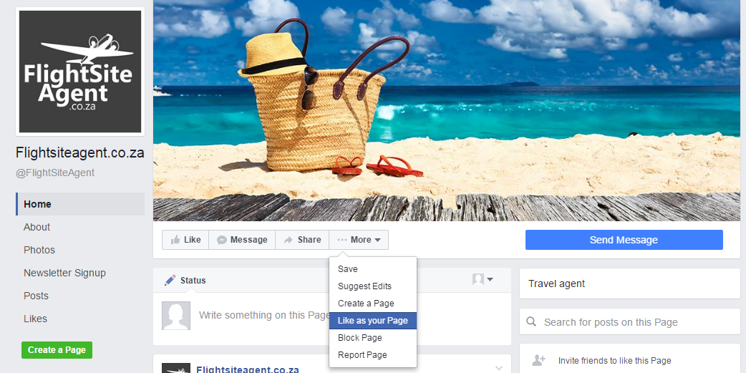
HOW TO SET UP A FACEBOOK BUSINESS PAGE
How do you get page likes?
Liking other pages as your Facebook business page
MARKETING TIPS

Slide 25
HOW TO SET UP A FACEBOOK BUSINESS PAGE
How do you get page likes?
Promoting your page for likes.
MARKETING TIPS

Slide 26
HOW TO SET UP A FACEBOOK BUSINESS PAGE
How do you get page likes?
Boosting a post for likes.
MARKETING TIPS

Slide 27
HOW TO SET UP A FACEBOOK BUSINESS PAGE
What you post is up to you
Share blog posts / relevant news articles eg. Samsung Galaxy Note 7 ban
Travel Updates
Inspirational posts
MARKETING TIPS

