Slide 1
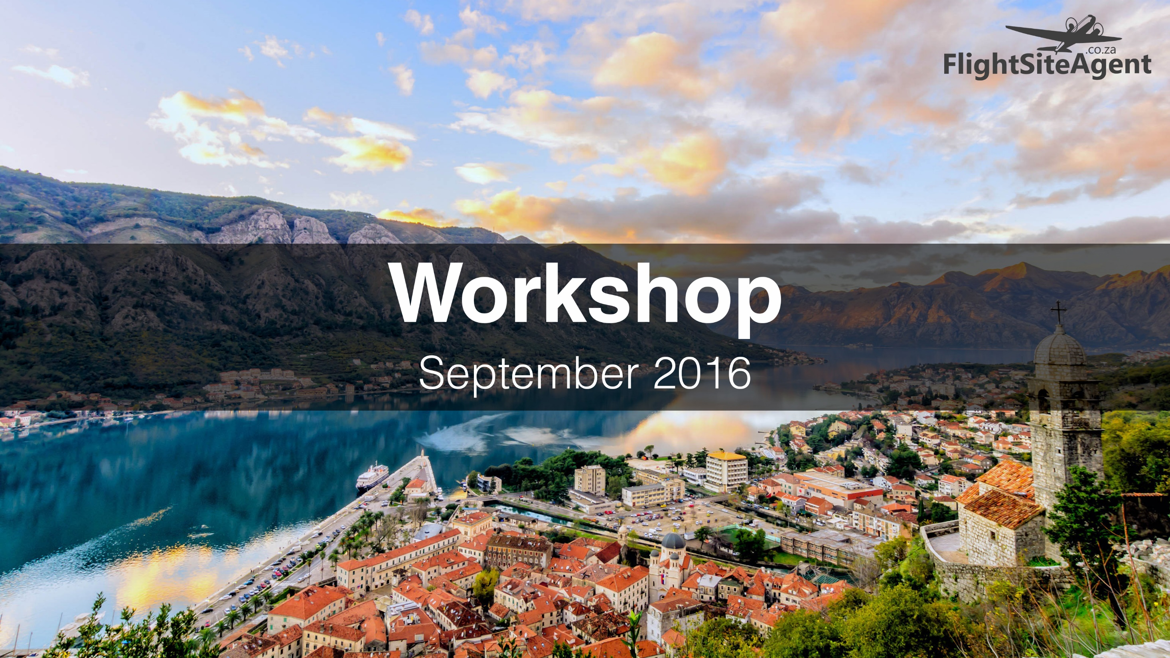

Workshop
September 2016

Slide 2
Agenda
1. Welcome by Kim Kral
2. System Tips by Matooka Boltman
3. Sales Tips by Kaashiefa Kolia
  The 8 Step Sales Process
  Are you selling the full range of travel products?
4. Marketing Tips by Astrid Beyers
  Social Media Do’s & Don’ts
  How to Send a Newsletter For Free

Slide 3
WELCOME
Kim Kral – General Manager

Slide 4
Questions?

Slide 5
SYSTEM TIPS
Matooka Boltman – Team Leader

Slide 6
Questions?

Slide 7
SALES TIPS
The 8 Step Sales Process
Are you selling the full range of travel products?
Kaashiefa Kolia – Sales Executive

Slide 8
THE 8 STEP SALES PROCESS
Step 1
Acknowledge the client or respond that you have received the email
Step 2
1. Build a rapport (connect on a personal level)
2. Qualify the client by asking relevant questions such as:
Have you travelled to the destination before?
Do you have a preferred airline?
Are you looking for the most direct flight?
Are you flexible by a few days either side of your requested date?
SALES TIPS

Slide 9
Step 3
Send the client 3 options:
1) Exactly what they have asked for e.g. British Airways if they wanted a direct flight.
2) A cheaper option might be due to longer connections or travelling a few days earlier or later.
3) Any other option e.g. Emirates via Dubai, Turkish via Istanbul, etc.
Step 4
Ask for feedback
1) Follow up the email with a call asking if your email was received.
2) Take the opportunity to explain why you quoted the other options as well.
SALES TIPS

Slide 10
Step 5
Cover any objections or questions at this point. If the client needs to chat to a spouse, confirm a time to follow up.
Step 6
Ask for the booking!! Can I hold the seats? Create a bit of urgency. Explain the GDS (Global Distribution System).
Step 7
Send the client the documents.
Step 8
A good sales person always follows up once client has returned.
SALES TIPS

Slide 11
ARE YOU SELLING THE FULL RANGE OF TRAVEL PRODUCTS?
SALES TIPS

Slide 12
Accommodation
When you are selling an air ticket you could be selling accommodation:
Hotel / Bed & Breakfast / Self-catering Accommodation / Backpackers Lodge
Two Options:
1. FlightSiteAgent Hotels OR
2. Booking.com (Refer to USB for link)
SALES TIPS

Slide 13
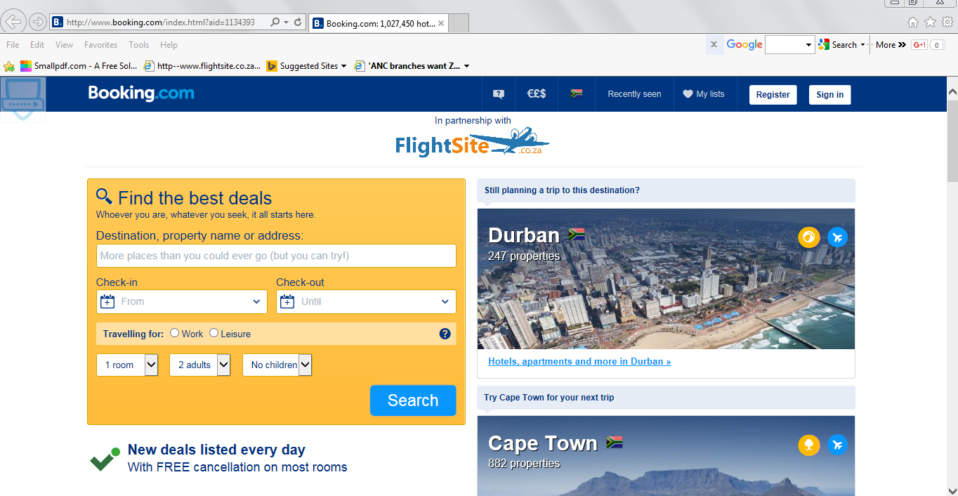
SALES TIPS

Slide 14
Travel Insurance
When you are selling an air ticket you could be selling travel insurance. It’s important that you as the agent make passengers aware of the importance of purchasing travel insurance for a number of reasons:
1. Unforeseen medical expense
2. Lost luggage cover
3. Flight cancellation cover
4. Peace of mind
SALES TIPS

Slide 15
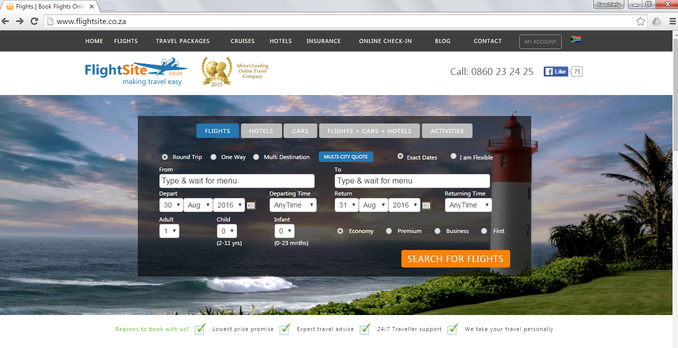
SALES TIPS

Slide 16
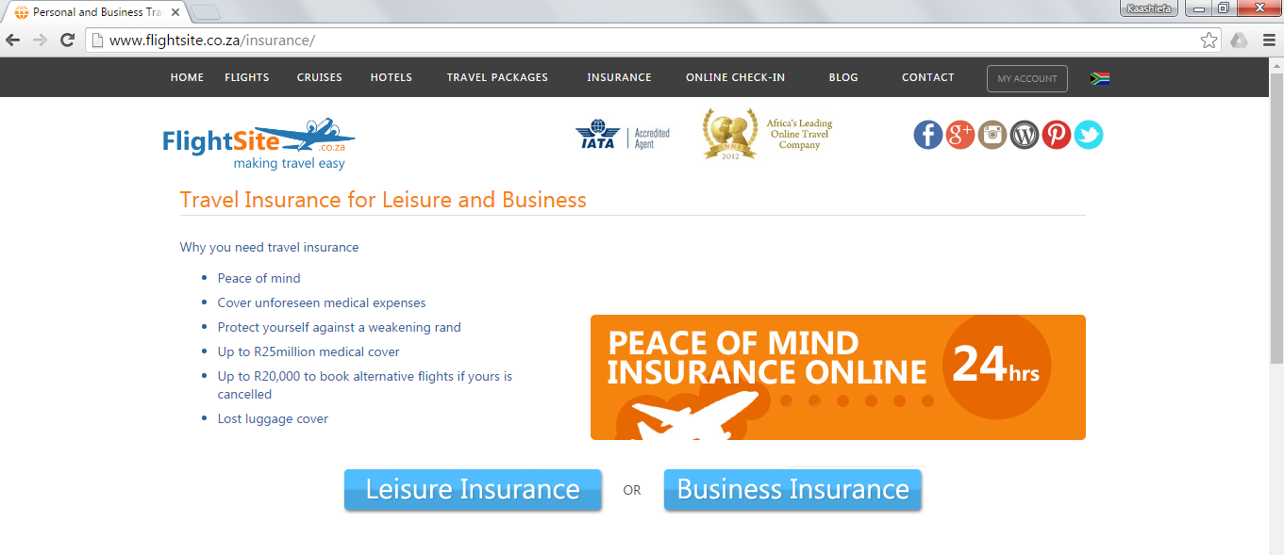
SALES TIPS

Slide 17
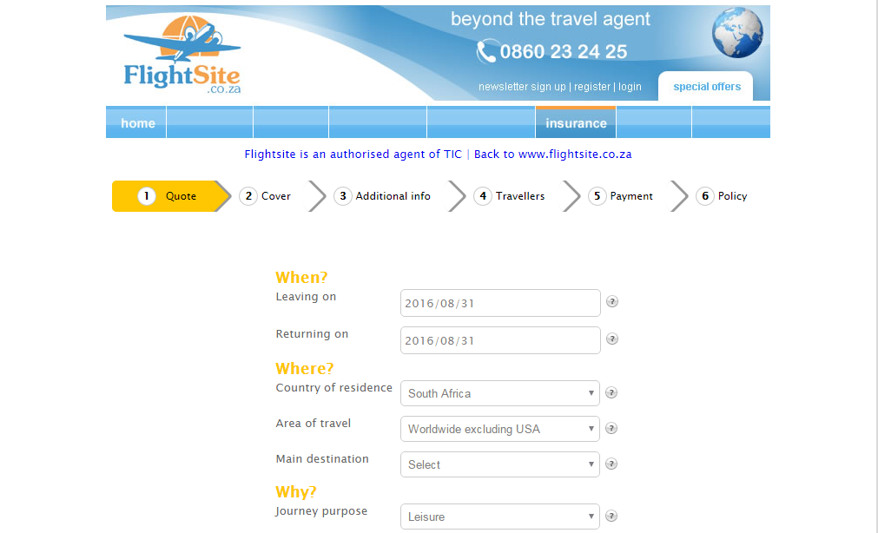
SALES TIPS

Slide 18
Airport Lounge Access
When you are selling an air ticket, include a quote for airport lounge access – this won’t take much time but it sets you apart from the internet. You are offering the passenger something he may not have thought about and that very thought of starting his/her holiday in VIP style may appeal to the passenger.
If you are interested in a login for Lounge Pass – please contact Kaashiefa@flightsite.co.za
SALES TIPS

Slide 19
Travel Packages
FlightSiteAgent has contracts in place with all major tour operators like:
Beachcomber Tours, Club Med 10%, Checkout Tours, Thompsons Tours, Trafalgar/Contiki Tours, The Holiday Factory, World Leisure Holidays
Most of the above operators pay a commission of 12% on land and 9% on air.
Quotes are sourced by sending a request to info@flightsiteagent.co.za
You as the FSA earn 75% of the commission earned which will be paid back to your FRAG once we have received the commission payment from the operator
SALES TIPS

Slide 20
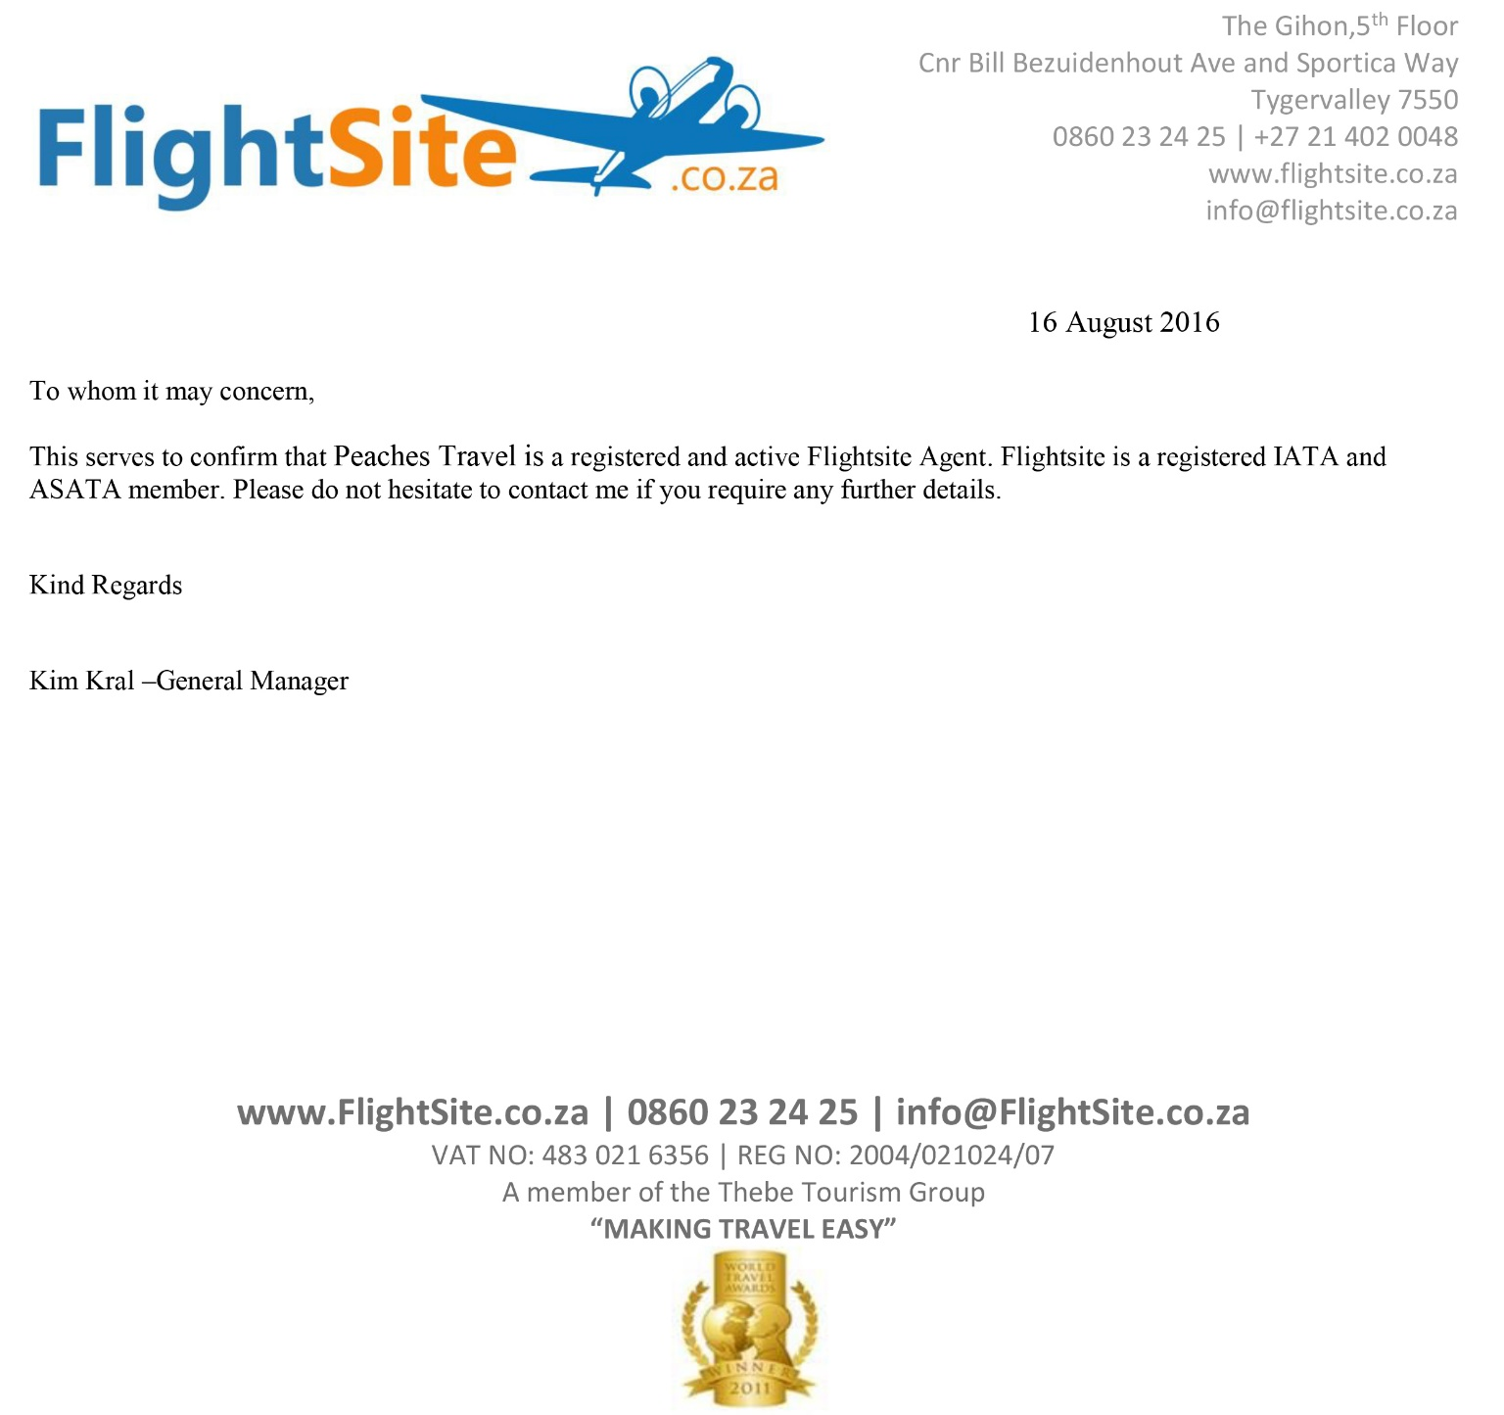
SALES TIPS

Slide 21
Travel Packages
You all know someone who has travelled or is planning to travel to Mauritius- Thailand- Zanzibar
A family member, a colleague, a neighbour, someone at your church, a friend of a friend
Packages are easy to sell, the operator puts everything together
Packages would normally include flights, airport – hotel – airport transfers, accommodation and one of the following meal plans (B&B is bed & breakfast, HB is half board so breakfast and dinner, AI is All Inclusive so all meals, snacks, drinks – certain premium brands may be excluded)
SALES TIPS

Slide 22
Travel Packages
Qualify your client
What are the holiday requirements: beach/relaxation /spa /golf /shopping /sightseeing - cultural landmarks/activities for kids
Which destinations have you travelled to before
Any preference for 3, 4 or 5 star accommodation
Meal Plan: B&B, HB or AI?
Are there children travelling along – age of children. Children own room or sharing
Approximate budget – this will help me get the quote correct, the first time round.
Any particular airline? What is preferred class of travel? Flexible with dates?
Remember to give the client 3 quotes, and remember to include travel insurance & lounge pass!
SALES TIPS

Slide 23
SALES TIPS

Slide 24
Very Important
Important Information:
UNABRIDGED BIRTH CERTIFICATES (UBC) : Immigration Regulation dictates that children under 18 require an UBC, along with their passports, when travelling. Please ensure that you apply for these certificates timeously.
Please ensure you have checked the visa and inoculation requirements. (Please ensure you check all transit points visa information).
For Visa information please check www.visas.co.za
Passports must be valid for 6 months AFTER your return to South Africa, please also ensure that you have a minimum of 2 blank pages in your passport.
Please be at the airport at least one hour before your domestic departures and at least 2 hours before your international departures.
Please also reconfirm ALL of your flights 72hours before departure between 9am-17h00pm with our office or directly with the airline.
Refer to USB document FSA Important Information for more details.
SALES TIPS

Slide 25
Questions?

Slide 26
MARKETING TIPS
SOCIAL MEDIA DO’s & DON’Ts
HOW TO SEND NEWSLETTERS FOR FREE
Astrid Beyers – Digital Copywriter

Slide 27
SOCIAL MEDIA DO’s & DON’Ts
Make it visual
  Google image search filters
  Crop with GIMP or MS Paint
2. Choose your tone and stick to it
3. Use the 80/20 ratio
  #TravelInspo vs Airline Sales
4. Stick to travel
5. Be active, not annoying
6. Timing
  Schedule on Facebook & Tweetdeck.co.za
7. Don’t like your own posts
8. Client feedback
  Make the bests of the good and the bad!
MARKETING TIPS

Slide 28
HOW TO SEND NEWSLETTERS FOR FREE
1. Sign up to a mailing service
There are a few options, but we use Mailchimp http://mailchimp.com/
  Free plan allows up to 2000 mailing addresses & 12 000 emails per month
  Easy to use – no advanced design skills required
2. Start gathering mailing addresses
  Save client names and emails in a Microsoft Excel list – be sure to get permission!
MARKETING TIPS

Slide 29
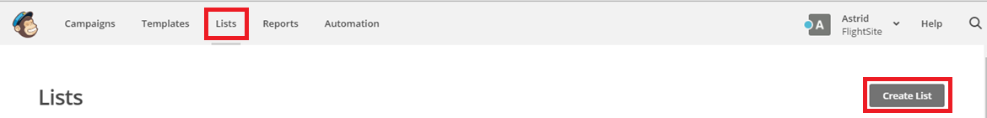
3. Import addresses into Mailchimp
  Create CSV file on Microsoft Excel (Save as CSV)
  Login to Mailchimp and click on LISTS on the grey menu at the top of page.
  Click on CREATE LIST in the right-hand corner.
MARKETING TIPS

Slide 30
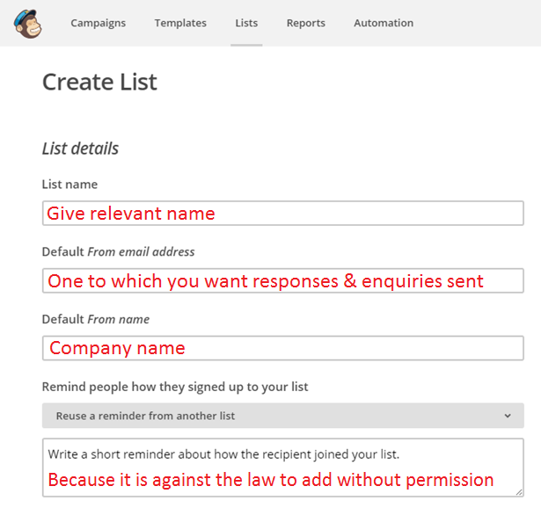
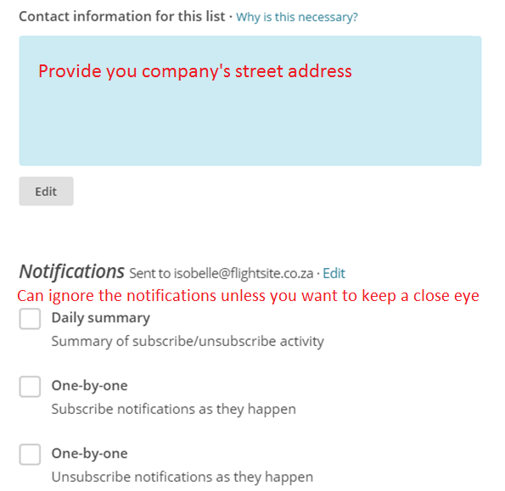
MARKETING TIPS

Slide 31
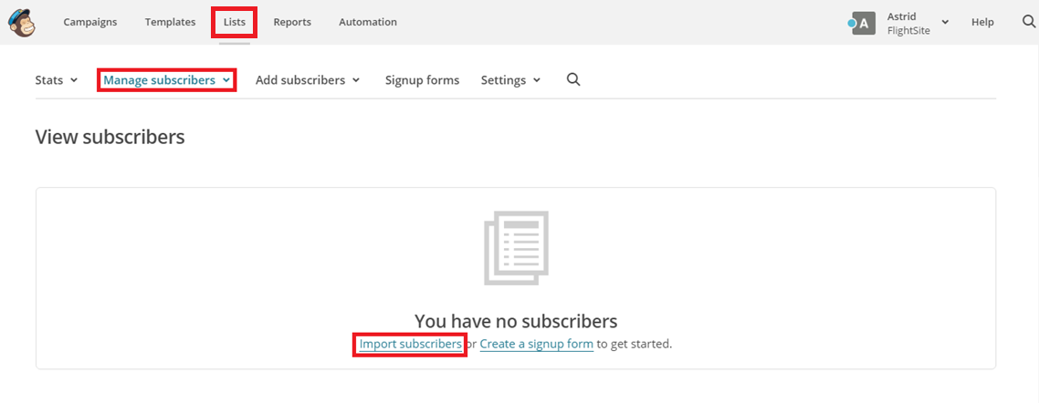
MARKETING TIPS

Slide 32
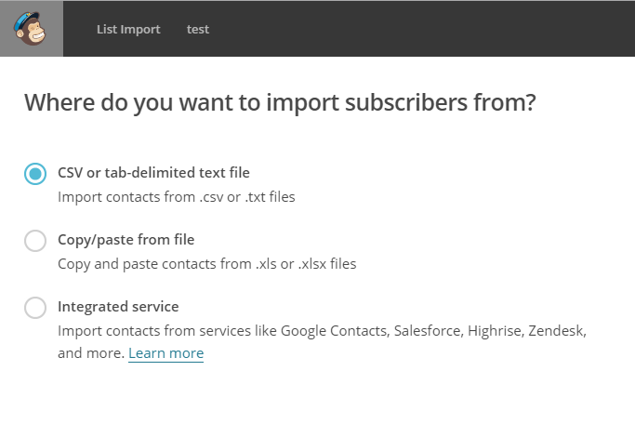
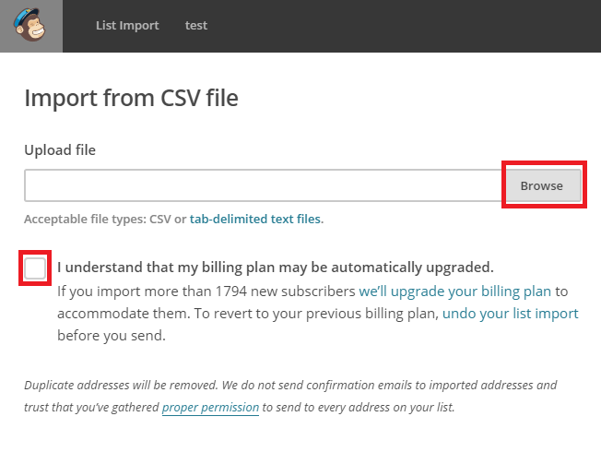
Upload CSV file by clicking on BROWSE and choosing the correct file. Click OPEN for it to upload.
Go to the NEXT page.
MARKETING TIPS

Slide 33
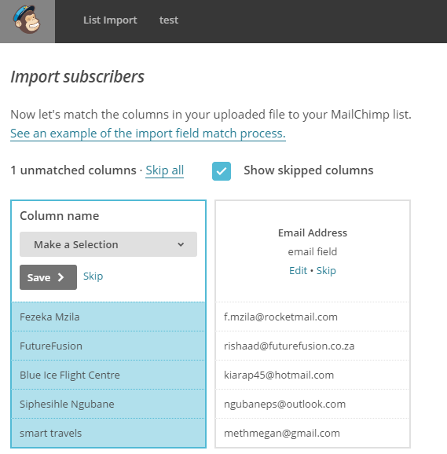
Name the columns: First Names, Surnames and email addresses.
Go to the NEXT page.

Slide 34
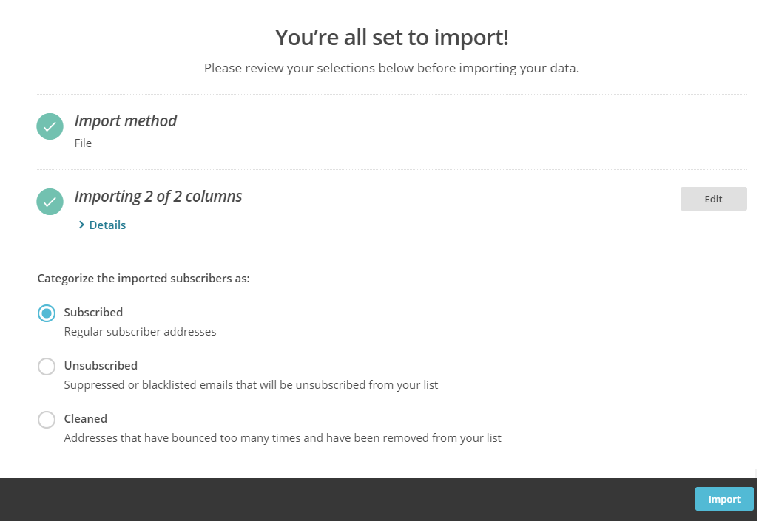
Click on IMPORT at the bottom of the page.
Your list will now be live!
MARKETING TIPS

Slide 35
4. Grow your newsletter base with signup forms
Go to LISTS, click on the relevant LIST name and then on SIGNUP FORMS.
You can do signup forms for:
FACEBOOK
Scroll down until you reach the Facebook form.
Click on LEARN MORE.
You’ll need to complete your Facebook integration. Follow these steps: http://bit.ly/1ZwlEd7
Follow these steps http://bit.ly/2bauEpg

Slide 36
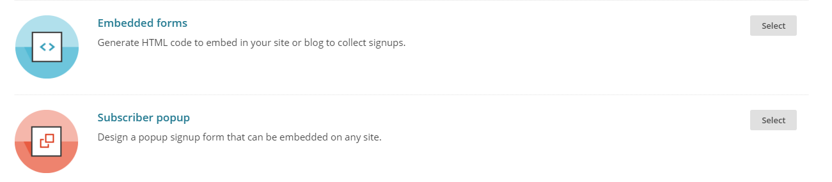
WEBSITE
Choose between an Embedded form and a Subscriber popup form.
Play around with the available designs and entry fields.
Think about where you will place it – whether it needs to be thin as it will be in a sidebar or horizontal as it will be at the bottom of the page.
Copy and paste the code onto the correct page of your website.
If you a Wordpress site, this would be a text widget.
MARKETING TIPS

Slide 37
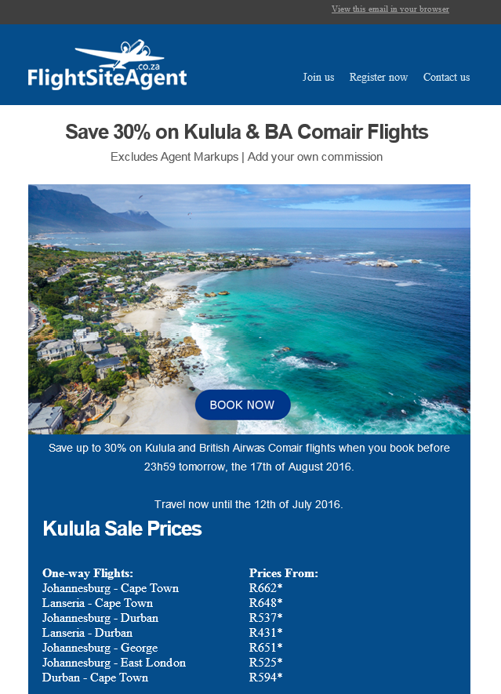
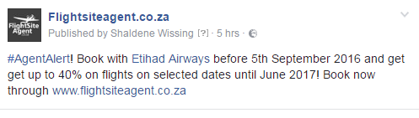
5. Newsletter Content
Keep the client’s interests in mind.
Use specials we advertise on social and newsletters – add your mark-up!
Keep it visual!

Slide 38
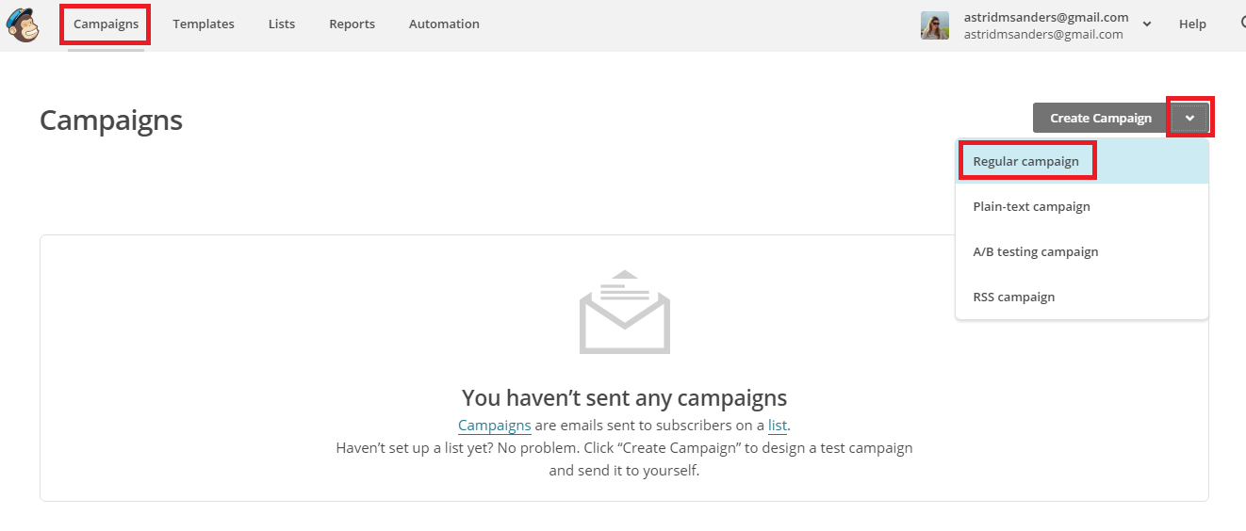
6. Designing your newsletter
MARKETING TIPS

Slide 39
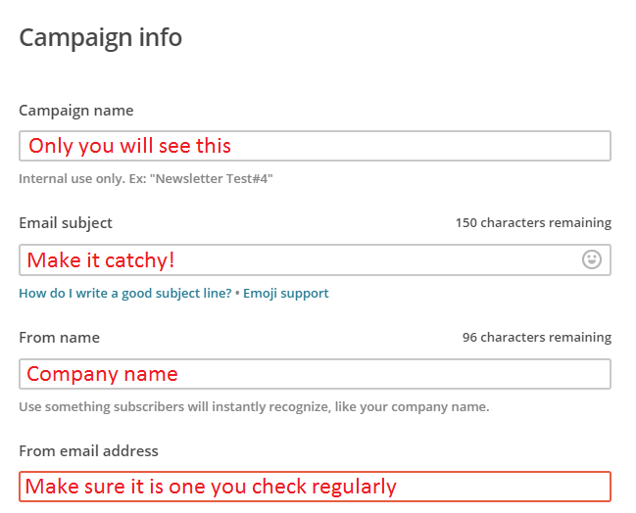
Choose the mailing list you want the campaign to be sent to and click on NEXT.
Complete the campaign info. Pay attention to your email subject!
Under tracking, you only have to track the opens, clicks and plain-text clicks.
Click NEXT once done.

Slide 40
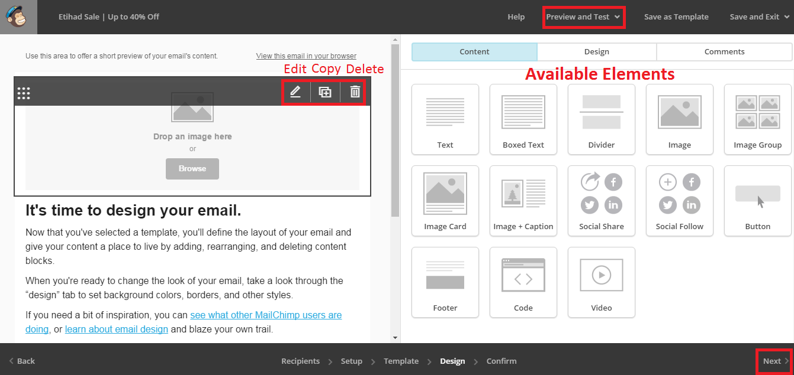
MARKETING TIPS

Slide 41
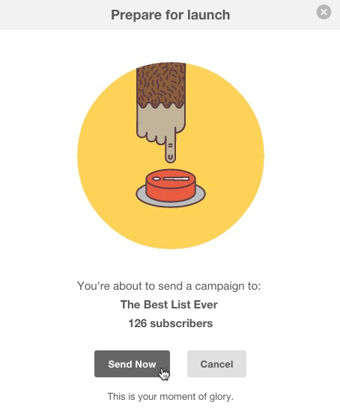
Select a Basic Template to start with for your layout.
In the Design mode you’ll be able to edit the newsletter layout and content.
You can delete elements, add new ones, drag and drop images and edit text.
Always test an email before sending to your subscribers!
Go back and make changes where necessary.
Click NEXT page.
Send your newsletter!

Slide 42
Questions?

Slide 43
Prize Draw

