Slide 2
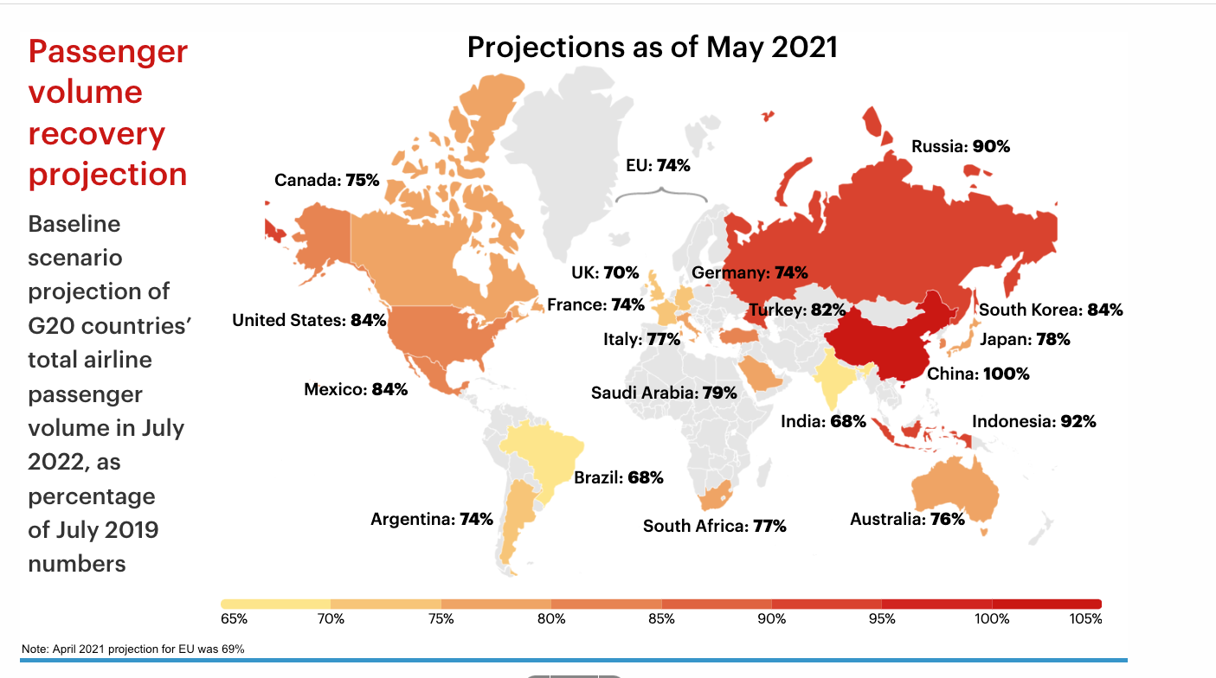
WHAT EXPERTS SAY WILL HAPPEN
Industry - Global Projections

Slide 3
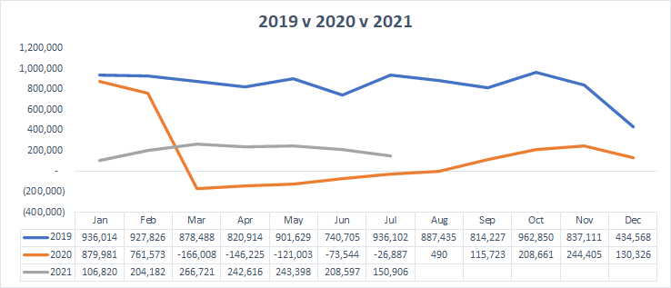
SA Industry GDS stats
Industry down 76% vs. 2019

Slide 4
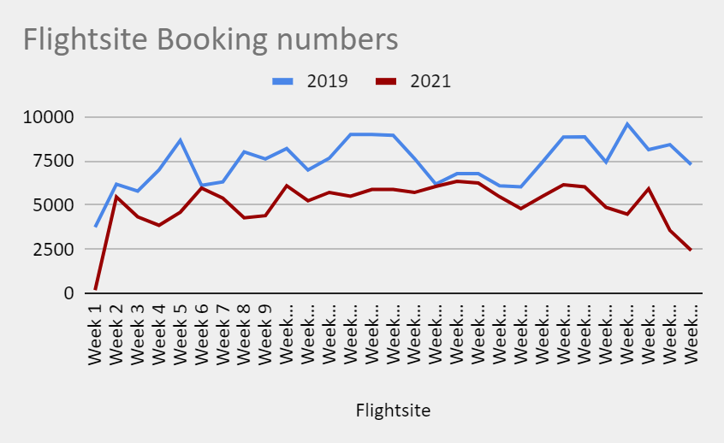
44% of 2019

Slide 5
Travel Trends
Family travel vs. Business travel
Lots of Local but also a Special trip
Last-minute bookings
Complexity
Flexibility
Travel agent vs. Travel pa

Slide 6
Where to from here?
Found a niche?
Building Trust?
Nourish Relationships – relative advantage?
Content is key – how easy is it to use and see?
Be yourself - compatibility with your own values?
Shareable incentives?

