Slide 1


Slide 2
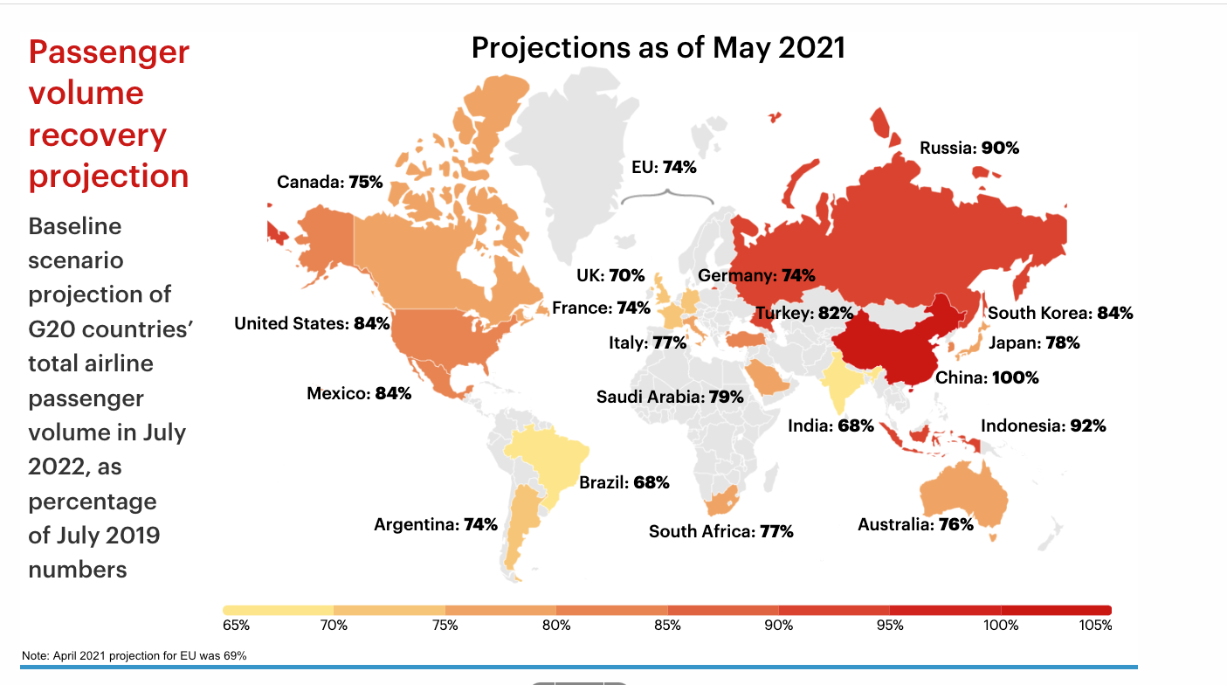
WHAT EXPERTS SAY WILL HAPPEN
Industry - Global Projections

Slide 3
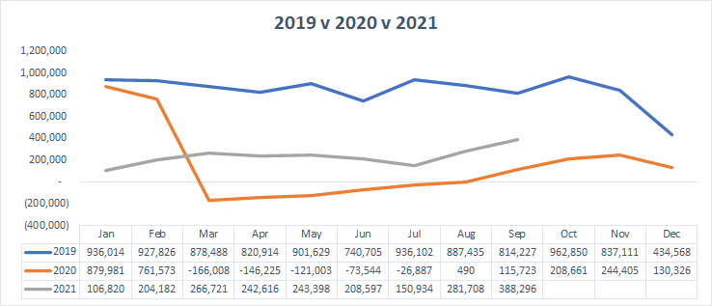
RESULTS AND OUTLOOK
Industry GDS stats
But only 52% down in Sept
Industry down 73% in 2021 (vs 2019)
INDUSTRY
BASED ON GDS STATS

Slide 4
Travel Trends
Family travel vs. Business travel
Lots of Local but also a Special trip
Last-minute bookings
Complexity
Flexibility
Travel agent vs. Travel pa

Slide 5
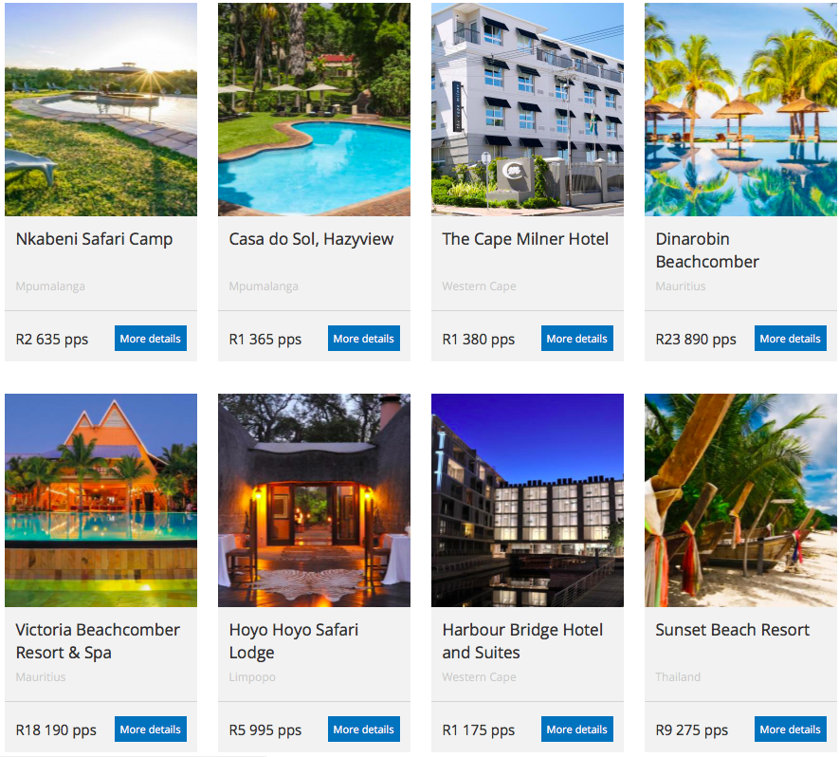

Slide 6
Where to from here?
Found a niche?
Building Trust?
Nourish Relationships – relative advantage?
Content is key – how easy is it to use and see?
Be yourself - compatibility with your own values?

